Slide 1
Metrics, Views, and Reports

Slide 2
Importance
Views and reports provide perspectives on data collected for health, risk, and capacity trending for the objects and fleet in your environment.
Although inbuilt views and reports are available to track metric data, you can also create your own custom views and reports for monitoring your environment.
You must understand the capabilities of views and reports, and when to use each function to monitor your private cloud deployment.

Slide 3
Module Lessons
Introduction to Metrics
Creating and Managing Views
Viewing and Managing Reports

Slide 4
Introduction to Metrics

Slide 5
Learner Objectives
Outline the role of metrics in VCF Operations
Distinguish between metrics and properties

Slide 6
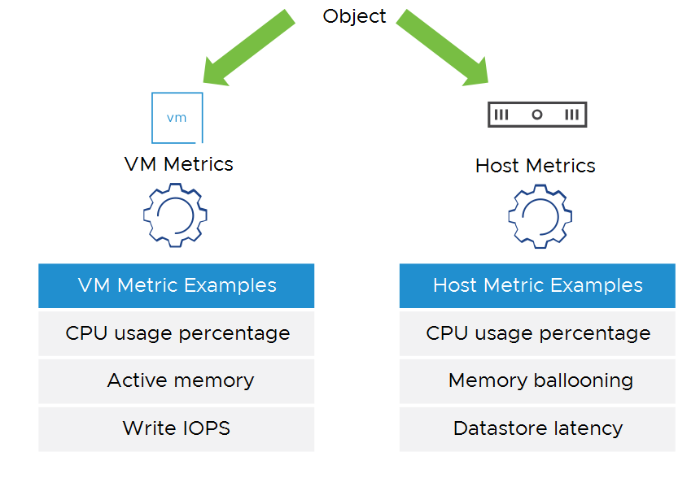
Understanding Metrics
Metrics are quantitative measurements collected from various objects, such as virtual machine, storage device, and so on. Metrics are usually time-based and numerical. Metrics data can reflect performance and health of the objects, such as CPU utilization, memory usage, network latency, etc.
VCF Operations can collect metrics data from such objects in your environment, use the metrics data in analysis, and provide key performance and health insights for environment optimization and troubleshooting.
Notes:
TalkTrack:
This slide introduces the fundamental concept of metrics within VCF Operations, which are crucial for understanding the health and performance of your virtual infrastructure. Metrics are essentially quantitative, time-based numerical measurements collected from various objects across your environment, such as virtual machines, physical hosts, storage devices, and more. This data provides critical insights into aspects like CPU utilization, memory usage, and network latency, reflecting the overall performance and health of these objects. VCF Operations is designed to systematically collect this metrics data from all relevant objects in your environment. This collected data then forms the basis for deep analysis within the platform, enabling VCF Operations to provide key performance and health insights. These insights are invaluable for optimizing your environment, identifying potential bottlenecks, and facilitating efficient troubleshooting when issues arise. For example, as shown, specific examples include VM metrics such as CPU usage percentage, active memory, and write IOPS, while host metrics might include CPU usage, memory ballooning, and datastore latency, all of which are essential indicators for proactive management.
<End>

Slide 7
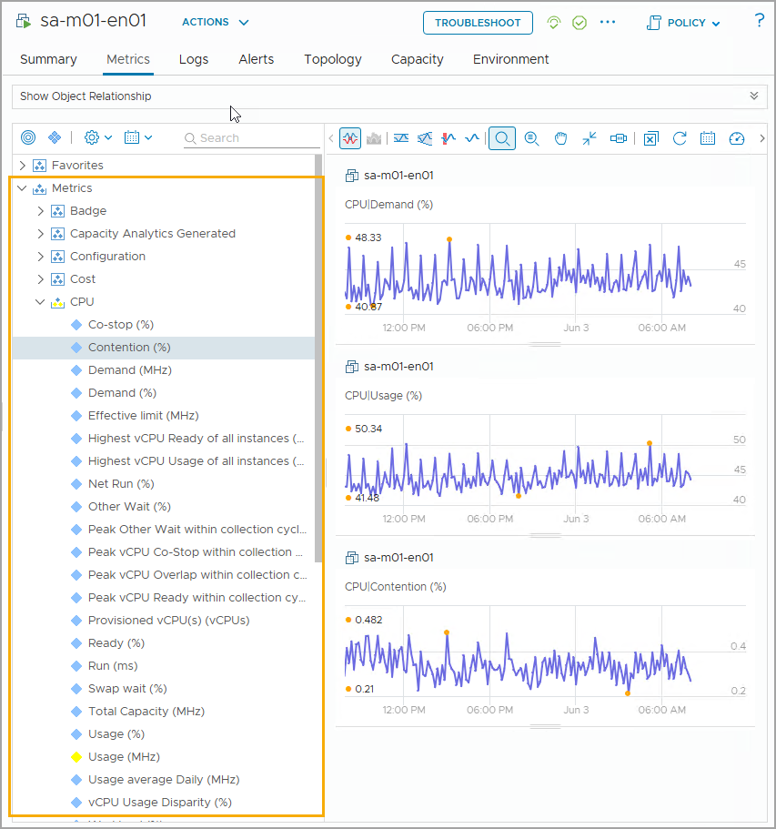
Understanding Predefined Metrics
VCF and VCF Operations are built to support various types of infrastructure objects powered by VMware and other third-party cloud infrastructure platforms. With this ability, VCF Operations can naturally collect a wide range of metrics from these infrastructure objects. These types of metrics are categorized as predefined metrics.
For example, VCF Operations can collect CPU usage, data store, memory utilization, disk space utilization, and network metrics from a virtual machine for administrators to understand its runtime statistics and performance condition.
Notes:
TalkTrack:
Building on our understanding of metrics, this slide delves into the concept of predefined metrics within VCF Operations. VCF Operations is inherently designed to support a vast array of VMware-powered infrastructure objects, such as virtual machines and hosts, as well as integrating with other third-party infrastructure platforms. This broad capability allows the platform to automatically collect a wide and comprehensive range of metrics from all these diverse infrastructure objects. These automatically collected metrics are categorized as predefined metrics, meaning they are standard, out-of-the-box data points that VCF Operations understands and can immediately use for analysis. For instance, VCF Operations can collect crucial performance indicators like CPU usage, datastore memory utilization, disk space utilization, and various network metrics directly from a virtual machine. This rich set of data enables administrators to establish baseline statistics for their environment and continually monitor performance conditions effectively. The visual in the slide demonstrates how these metrics are presented within the VCF Operations console, allowing users to drill down into specific performance counters and visualize trends over time, which is invaluable for proactive monitoring and troubleshooting.
<End>

Slide 8
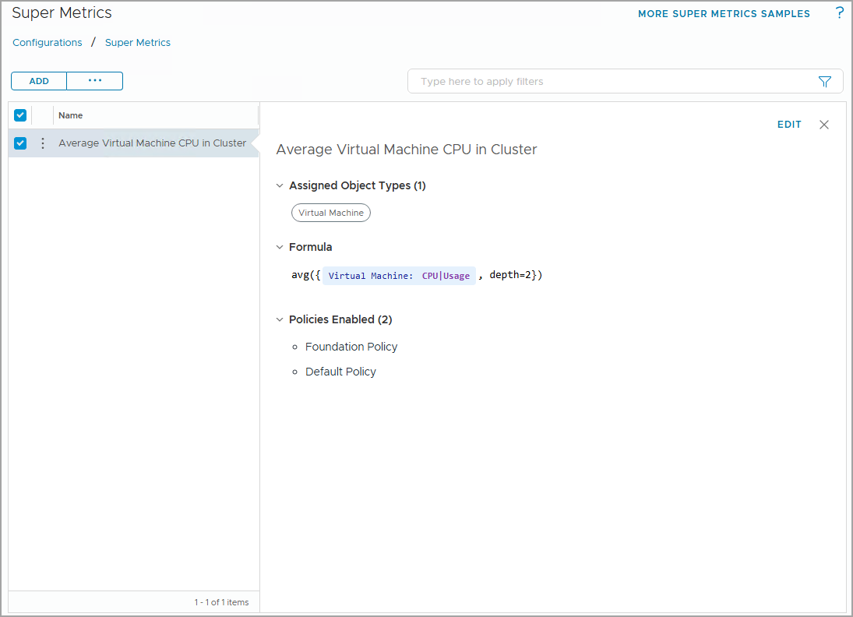
Understanding Super Metrics
A Super Metric in VCF Operations is a custom metric that you can create when you want to check the health of your environment but cannot find a suitable metric to perform the analysis.
In a super metric, you can include multiple metrics and formula expressions to calculate the desired metric. For example, you can create a super metric to calculate the average virtual machine CPU utilization across an entire cluster.
Notes:
TalkTrack:
Building upon our understanding of basic and predefined metrics, this slide introduces a powerful capability within VCF Operations called "Super Metrics". A super metric is a custom metric that you can create when the existing predefined metrics do not fully capture the specific health or performance insights you require for your environment analysis. For instance, if you need to calculate the average CPU utilization across all virtual machines within an entire cluster, a super metric is the ideal tool. To create a super metric, you navigate to Infrastructure Operations, then select Super Metrics, and click Add. The process involves several steps: First, you define the super metric's name and provide a clear description. Next, using the Object Types dropdown menu, you select the specific objects that this super metric will be associated with. For our example, this would be a virtual machine. The core of a super metric lies in configuring its formulas and metrics. Here, you can utilize various functions like "average," "sum," or "count" and combine them with existing metrics. You can locate the necessary metrics for your expression using the Object and Object Type selectors. For instance, to calculate average CPU usage, you would input "vm:cpu|%usage". Finally, you select a policy to associate with this new super metric. A critical concept when defining super metrics is "depth." By default, an expression has a depth of one, meaning the metric is assigned to an object one level above the virtual machines in the relationship chain. However, if your super metric is for a cluster, which is two levels above a virtual machine, you would adjust the depth to two to accurately reflect the aggregation scope. The depth can even be negative, which is used when aggregating the parents of a child object, such as aggregating all VMs in a datastore. Understanding and correctly configuring this depth ensures that your custom super metrics provide precise and meaningful insights into your environment.
<End>
To create a super metric, navigate to Infrastructure Operations > Configurations, then select Super Metrics. To add a new super metric, click Add:
Set up the super metric name and description.
Use the Object Types dropdown menu to include the objects that will be associated in this super metric.
Configure the formula and metrics.
You can type or use Function to add operators, such as avg, sum, count, and etc.
You can use Object Type and Object to locate the metric you need to include in this expression.
Select any policy you wish to associate with this super metric.
In this example, a super metric is created to capture the average CPU usage across all virtual machines in a cluster:
In the super metric editor, enter avg and select the avg function.
Enter Virtual and select Virtual Machine from the object type list.
Enter usage, and select the CPU|Usage (%) metric from the metric type list.
Change the depth to depth = 2
The expression ends with depth=1 by default. If the expression ends with depth=1, that means that the metric is assigned to an object that is one level above virtual machines in the relationship chain. In this example, however, since this super metric is for a cluster which is two levels above virtual machine in the relationship chain, the depth should be 2.
The depth can also be negative, this happens when you need to aggregate the parents of a child object. For example, when aggregating all the VMs in a datastore, the metric expression ends with depth=-1, because VM is a parent object of datastore. But, if you want to aggregate all the VMs at a Datastore Cluster level, you need to implement 2 super metrics. You cannot directly aggregate from VM to Datastore Cluster, because both are parents of a datastore. For a super metric to be valid, depth cannot be 0 (-1+1=0). Hence, you need to create the first super metric (with depth=-1) for the aggregate at the datastore level, and then build the second super metric based on the first (with depth = 1).

Slide 9
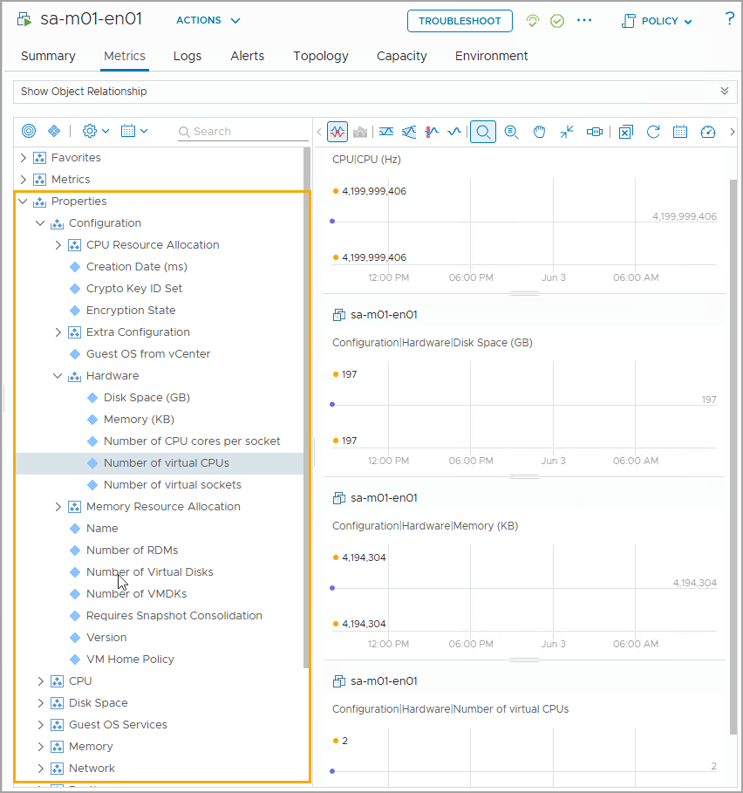
Understanding Property
Properties are attributes or characteristics collected from various objects. Properties are descriptive and non-time-based, and property values usually do not change frequently. Examples of properties include VM names, number of CPU cores per socket, number of virtual disks, etc. Properties data are often useful for planning system setups, grouping, and other high-level decision making.
VCF Operations can collect properties data from objects in your environment. Administrators can use the properties data to understand configuration and state of resources.
Notes:
TalkTrack:
This slide introduces "properties," which are another fundamental type of data collected and leveraged by VCF Operations, complementing the metrics we previously discussed. Properties are essentially attributes or characteristics gathered from various objects within your environment. Unlike metrics, which are quantitative, time-based, and numerical, properties are descriptive and typically non-time-based. Their values usually do not change frequently. Examples of properties include virtual machine names, allocated disk space, or the number of virtual disks. This property data is exceptionally useful for various high-level activities such as capacity planning, system setup, organizing resources into logical groups, and supporting overall strategic decision-making. VCF Operations is designed to effectively collect this property data from all objects in your environment, providing administrators with a clear understanding of the configuration and current state of their resources. The console screenshot on the slide illustrates how these properties are presented, allowing users to view detailed attributes of selected objects, which is critical for configuration management and effective resource governance.
<End>

Slide 10
Review of Learner Objectives
Outline the role of metrics in VCF Operations
Distinguish between metrics and properties

Slide 11
Creating and Managing Views

Slide 12
Learner Objectives
Outline the role of views in VCF Operations
Create a basic custom view and configure view settings

Slide 13
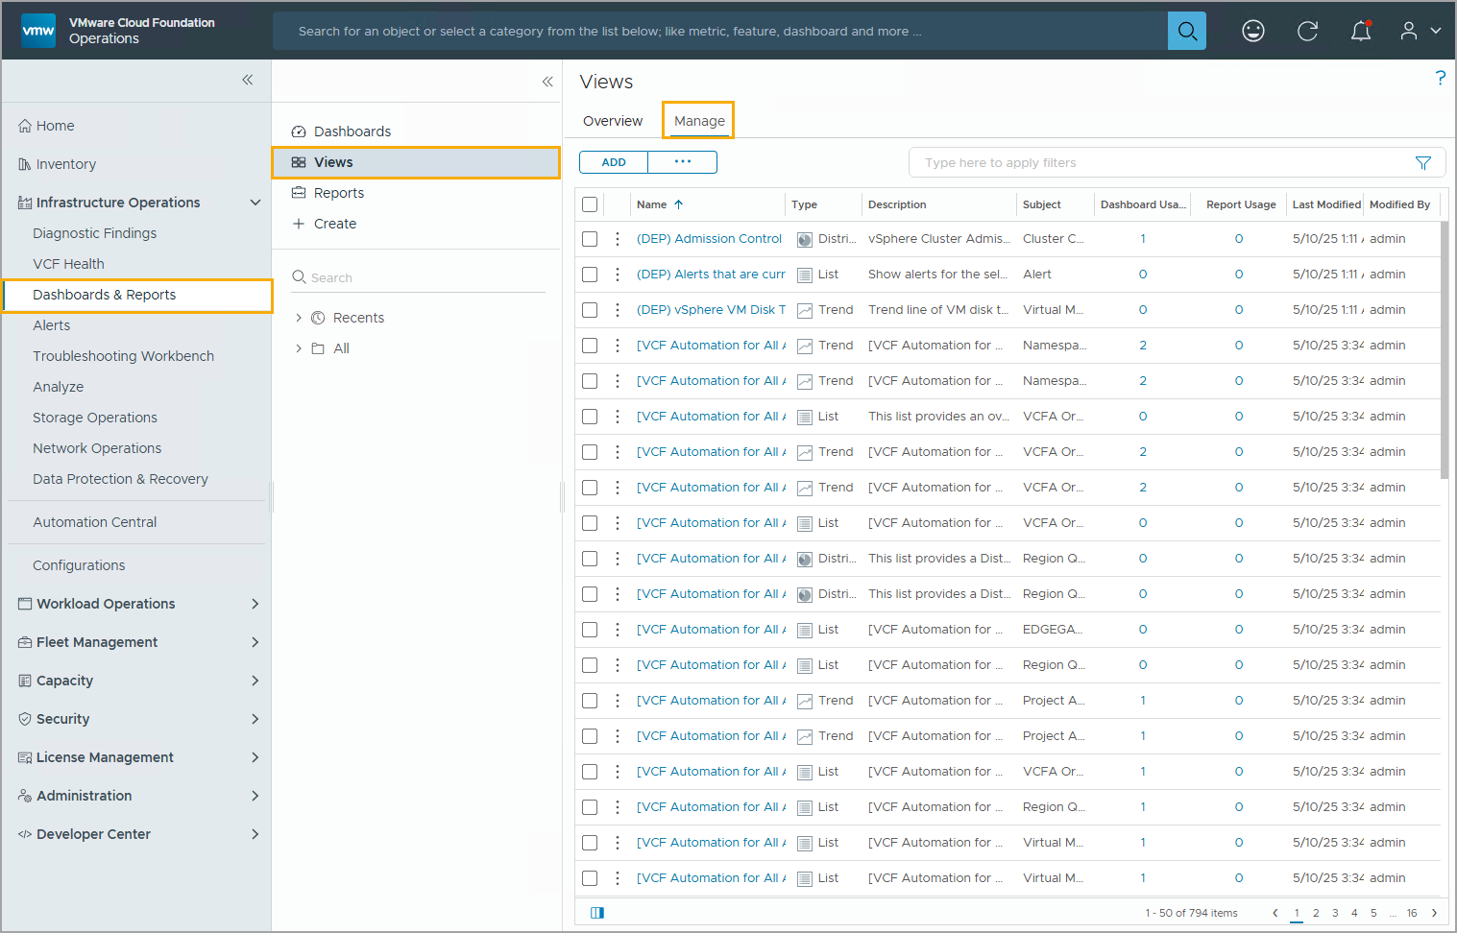
Understanding Views
A View in the VCF Operations console can display metrics collected from the environment. Views are also reusable building blocks for building dashboards and reports.
You can display and manage views by clicking Infrastructure Operations > Dashboards & Reports > Views.
In the Views pane, click Manage to see all the views currently available.
Notes:
TalkTrack:
This slide introduces the concept of "Views" within the VCF Operations console, which are essential for visualizing and interpreting the vast amount of data collected from your environment. A view serves as a powerful display mechanism for metrics and properties, and it also acts as a reusable building block that can be incorporated into customized dashboards and comprehensive reports. This modularity allows for efficient creation of tailored operational insights. To access and manage these views, you navigate through the VCF Operations console by clicking on Infrastructure Operations, then selecting Dashboards & Reports, and finally choosing Views. Once in the Views pane, clicking the Manage option will present you with a comprehensive list of all currently available views. These views are instrumental in helping you interpret the metrics, properties, and policies of your monitored objects, including any associated alerts and symptoms. For streamlined analysis, these views are logically categorized into several key areas: Availability, Capacity, Configuration, Inventory, Performance, and Compliance, allowing you to quickly focus on specific aspects of your infrastructure's health and performance.
<End>
Views help you to interpret metrics, properties, and policies of monitored objects including alerts and symptoms.
The views are categorized as follows: Availability, Capacity, Configuration, Inventory, Performance, and Compliance.

Slide 14
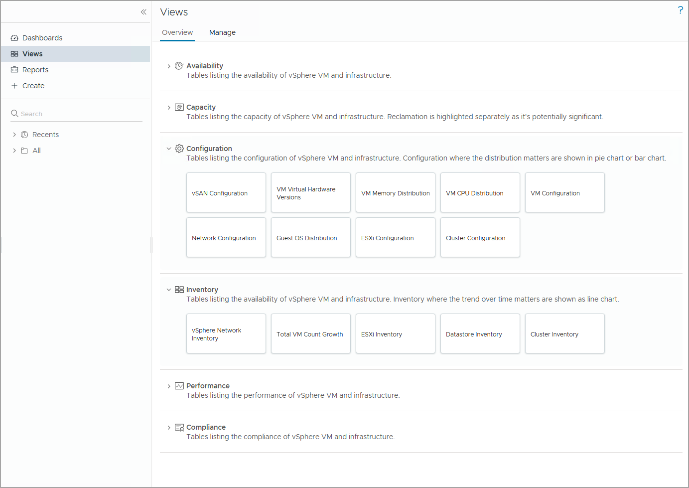
Predefined Views
Predefined views are available in VCF Operations. Each view is based on a subject.
A view presents collected information for VCF and other objects in your environment in a certain way depending on the view type.
Notes:
TalkTrack:
This slide specifically focuses on the "Predefined Views" available within VCF Operations, building upon our previous discussion about the general utility of views for data visualization. Predefined views are out-of-the-box views that come with VCF Operations, designed to provide immediate insights into your environment. Each of these views is structured around a specific subject, making it easy to focus on particular aspects of your infrastructure. Essentially, a predefined view presents collected information for VCF components and other objects in your environment in a structured and meaningful way, with the presentation varying based on the view type. As illustrated in the console screenshot, these views are categorized to help you quickly navigate to the relevant data. The categories include: Availability, which shows the readiness of your vSphere VM and infrastructure; Capacity, focusing on resource utilization and planning; Configuration, detailing various settings like vSAN configuration and VM hardware versions; Inventory, providing lists and details of assets; Performance, for monitoring performance trends; and Compliance, ensuring adherence to policies. It's important to remember that while these predefined views are readily available, any data collected by VCF Operations adapters can be used in a view or report. Furthermore, users with appropriate privileges have the flexibility to create their own custom views, tailoring the insights precisely to their specific operational needs.
<End>
Any data that any adapter collects can be used in a view or report. Although predefined views are available, any user with the correct privileges can create custom views.

Slide 15
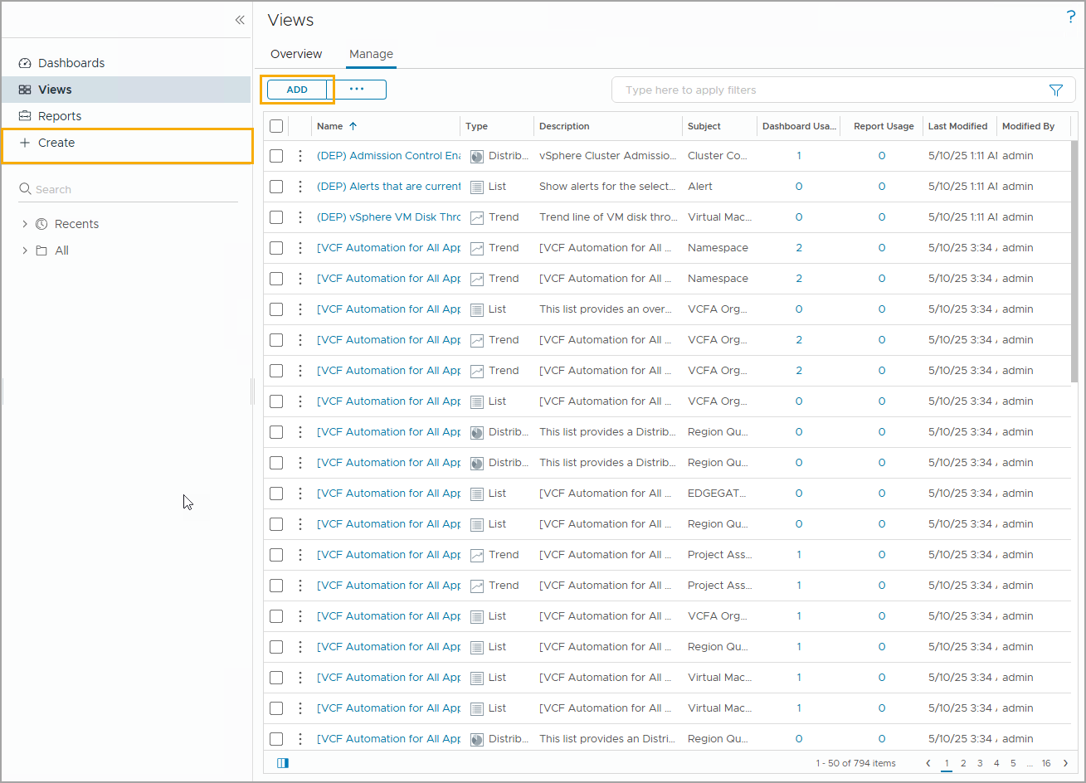
Creating a Custom View
You can create a custom view to collect and display information for a specific object. To add a new view, click the ADD button or click + Create.
You need to complete the following tasks when creating a custom view:
Specify the view type.
Configure subjects and metrics.
Configure the time settings.
Add any data filter.
Notes:
TalkTrack:
This slide moves beyond predefined views to empower you with the ability to create "Custom Views" within VCF Operations. A custom view allows you to precisely collect and display information tailored to a specific object or set of objects, ensuring you get the exact insights you need. To begin creating a new custom view, you simply click either the Add button or the + Create option within the Views section of the console. The process for building a new custom view involves completing a series of logical steps. First, you must specify the desired view type, which determines how your data will be presented. Next, you configure the subjects and metrics that will be included in your view, selecting the specific objects and data points you wish to monitor. Following this, you set the time settings, defining the historical period over which the data will be displayed. Finally, you can add any necessary data filters to refine the information, ensuring that your view focuses only on the most relevant data. This capability allows you to build highly specialized monitoring dashboards and reports that directly address unique operational requirements.
<End>

Slide 16
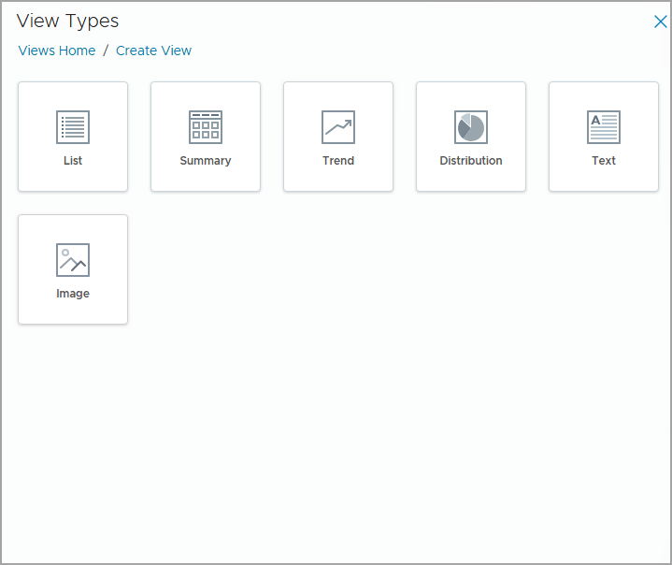
Understanding View Types
When you create a view, you first need to choose a view type. Each type of view helps you to interpret metrics and properties in a different way.
The following view types are available to choose from:
List views: Provide tabular data about specific objects
Summary views: Provide tabular data about the use of resources
Trend views: Use historic data to generate trends and forecasts for resource use and availability
Distribution views: Provide aggregated data about resource distribution
Text views: Allow you to insert provided text
Image views: Allow you to insert a static image
Notes:
TalkTrack:
This slide provides a deeper dive into the first crucial step when creating a custom view: understanding and selecting the appropriate "View Type". When you embark on creating a new view, your initial decision will be which type of view best suits the information you intend to present, as each type is designed to interpret metrics and properties in a distinct way. VCF Operations offers several view types to choose from: The "List" view provides tabular data about specific objects, which is excellent for detailed inventories. For this view type, the column count is limited to 25 in PDF reports and 50 in CSV reports, though the page count itself is unlimited. A "Summary" view presents tabular data focused on the utilization of resources in your environment. The "Trend" view is designed to use historical data to generate trends and forecasts, giving you predictive insights into resource use and availability. For aggregated data on how resources are distributed across your environment, you would select the "Distribution" view. The "Text" view allows you to insert plain or dynamic text, which can include metrics and properties, providing contextual information or specific notes within your view. Finally, the "Image" view enables you to insert a static image into your view. By default, the image view is primarily available when creating or modifying report templates, but its visibility can be adjusted in the view workspace's visibility step. Your selection of view type should always align with the kind of information you wish to display for the monitored objects in your environment.
<End>
The type of view that you must select depends on the type of information that you want to show for the monitored objects in your environment.
The following types of views are available in VCF Operations:
List: Provides tabular data about specific objects in the monitored environment. Column count is limited to 25 in a PDF report and 50 in a CSV report. The page count is unlimited.
Summary: Provides tabular data about the use of resources in your environment.
Trend: Uses historic data to generate trends and forecasts for resource use and availability in the monitored environment.
Distribution: Provides aggregated data about the resource distribution in the monitored environment.
Text: Inserts and displays text on the view. The text can be dynamic and contains metrics and properties.
Image: Inserts a static image. By default, the image view is available only when creating and modifying the report template. You can change the view on the Visibility step of the view workspace.

Slide 17
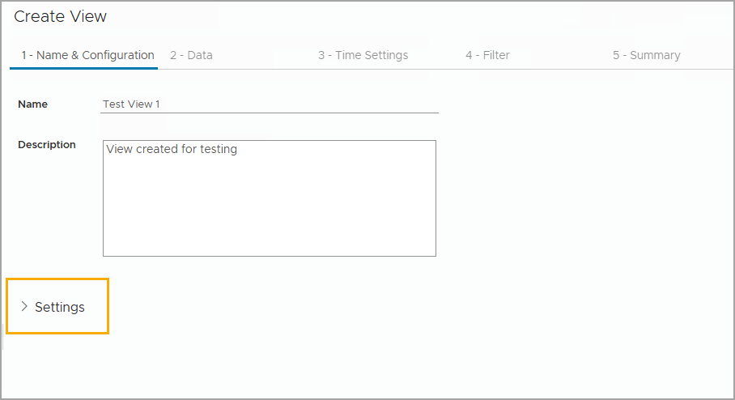
Specifying the View Name and Configuration
You must specify the name and description of the view as they appear in the list of views on the Views page. Click Settings to configure visibility for the view.
Notes:
TalkTrack:
This slide focuses on the initial configuration step when creating a custom view, specifically "Specifying the View Name and Configuration". After selecting your desired view type, the first task is to define how your new view will be identified and described within the VCF Operations console. You are required to specify a unique name and a clear description for the view, which will then appear in the list of available views on the Views page. As illustrated in the screenshot, this is typically done on the "Name & Configuration" tab of the Create View wizard. Providing a descriptive name and description is crucial for organizational purposes, especially as your number of custom views grows, ensuring that you and other administrators can easily identify the purpose and content of each view. Additionally, this screen includes a "Settings" link. By clicking this, you can further configure the visibility of the view, controlling who can see and access it, which is an important aspect of managing access control within your VCF Operations environment. This foundational step ensures your custom view is properly identified and discoverable for future use.
<End>

Slide 18
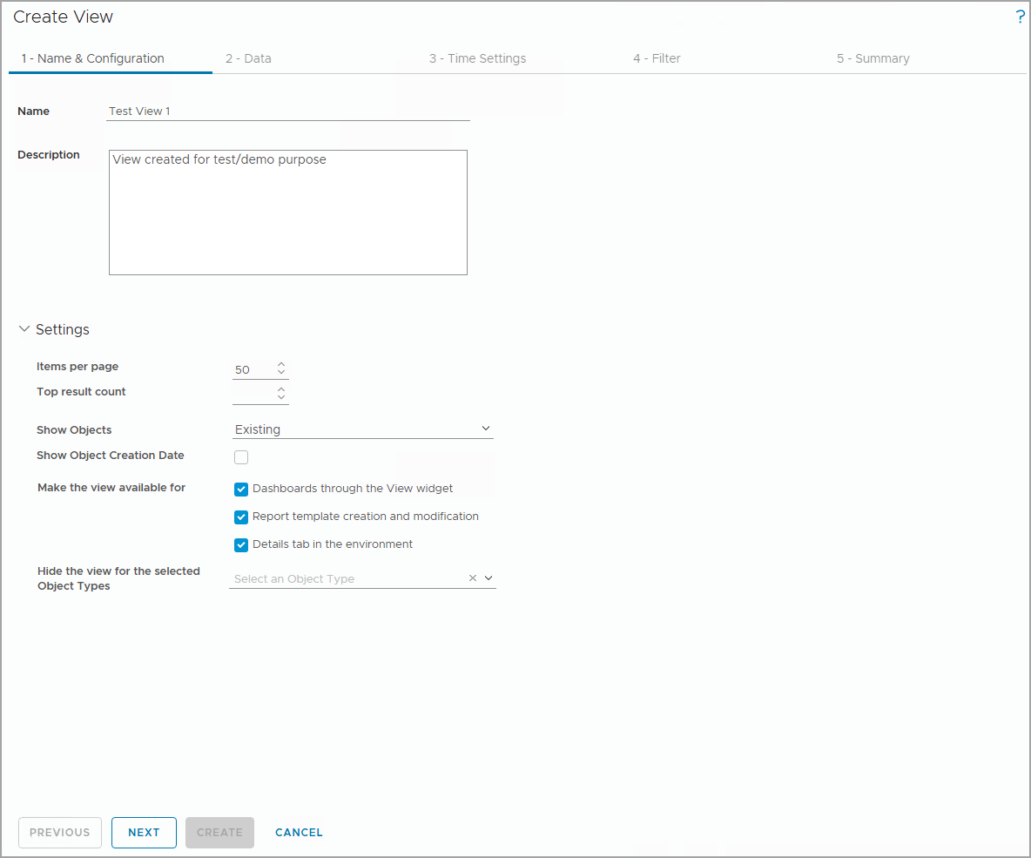
Configuring View Visibility Settings
In View Visibility Settings, you can specify where the view appears and where it can be reused, such as when creating Dashboards and Reports.
You can customize result display, such as items per page, maximum plot lines, etc. This setting varies based on different view types.
You can also specify object types in which the view is not available.
Notes:
TalkTrack:
This slide focuses on "Configuring View Visibility Settings," which is a crucial aspect of managing your custom views within VCF Operations. These settings allow you to control precisely where your newly created view appears and how it can be re-used across the platform, for instance, when integrating it into dashboards or reports. Within these settings, you have the flexibility to customize the display of the results. This includes adjusting parameters such as the number of items shown per page and the maximum number of plot lines in charts. It's important to note that these display options can vary depending on the specific view type you have selected. Furthermore, you can define which object types the view should not be available for, providing granular control over its applicability. As an example, if you create a view specifically for virtual machines, it will generally be accessible from dashboards, reports, and directly from an object's details tab. This view would be visible when you navigate through any of the virtual machine's higher-level ancestors, such as a host or a data center. However, if you choose to explicitly hide the view for a data center using the "Hide the view for the selected Object Types" dropdown, then that specific view will not be visible when you are at the data center level in the console. These controls ensure that your views are presented contextually and relevantly to the users.
<End>
In the example, the view is accessible from dashboards, reports, and the object’s Details tab. You can also specify an object type for which you do not want to see this view. For example, you create a view for virtual machines. The view is visible when you select any of the virtual machine’s ascendants, such as a host or a data center. If you select data center from the Hide the view for the selected Object Types drop-down menu, the view is not visible at the data center level.

Slide 19
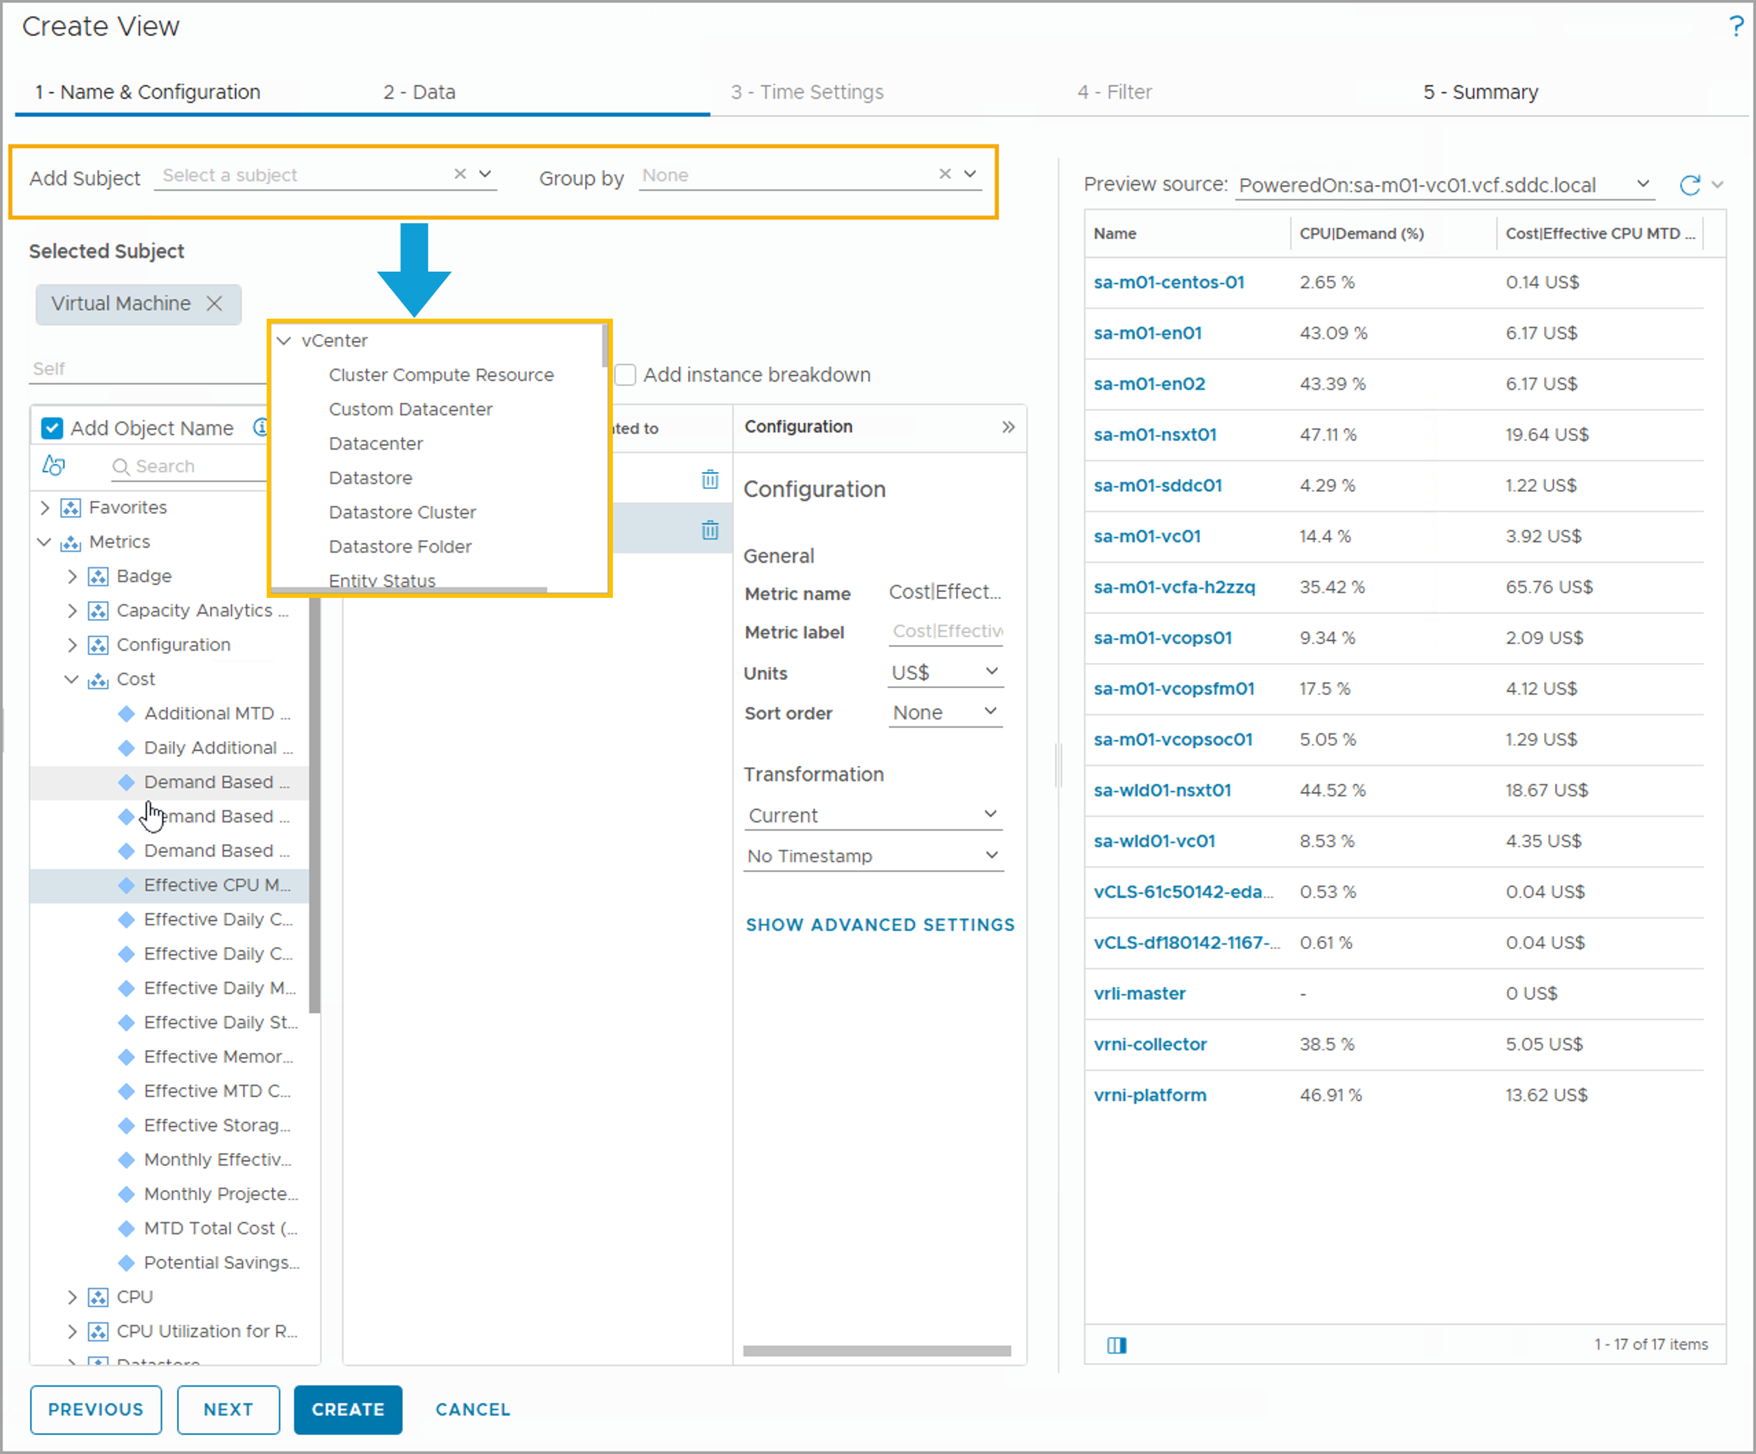
Adding Data Subject
When creating a view, you need to specify the data subjects for this view. A subject is the base object type for which the view shows information.
You can use the Add Subject drop-down menu to select the desired data subjects. Or you can enter keywords in the Add Subject field and select the desired data subjects from the search result list.
The subject that you specify determines where the view is applicable. If you select more than one subject, the view is applicable for each subject.
Notes:
TalkTrack:
This slide advances our discussion on creating custom views by focusing on the "Adding Data Subject" step, found under the "2 - Data" tab of the Create View wizard. When building a custom view, it is essential to specify the data subject or subjects for that view. A subject fundamentally defines the basic object type for which your view will display information. This could be a virtual machine, a host, a datastore, or any other monitored entity in your environment. You have two primary ways to select your desired data subjects: you can use the Add Subject dropdown menu to browse and choose from a predefined list, or you can type keywords directly into the Add Subject field and select from the search results. The subject you specify is critical because it directly determines where your custom view will be applicable within the VCF Operations console. For instance, as shown in the example, if "Virtual Machine" is selected as the subject, then the view will be applicable for all virtual machines. If you select more than one subject, the view's applicability extends to each of those chosen subjects. Additionally, in list views, you have the ability to group the results based on a parent object by utilizing the "Group by" dropdown menu, which further enhances the organization and interpretation of your data.
<End>
In the list view, you can group the results based on a parent object, by selecting the Group by drop-down menu.
In the example, Virtual Machine is selected so that the view is applicable for virtual machines.

Slide 20
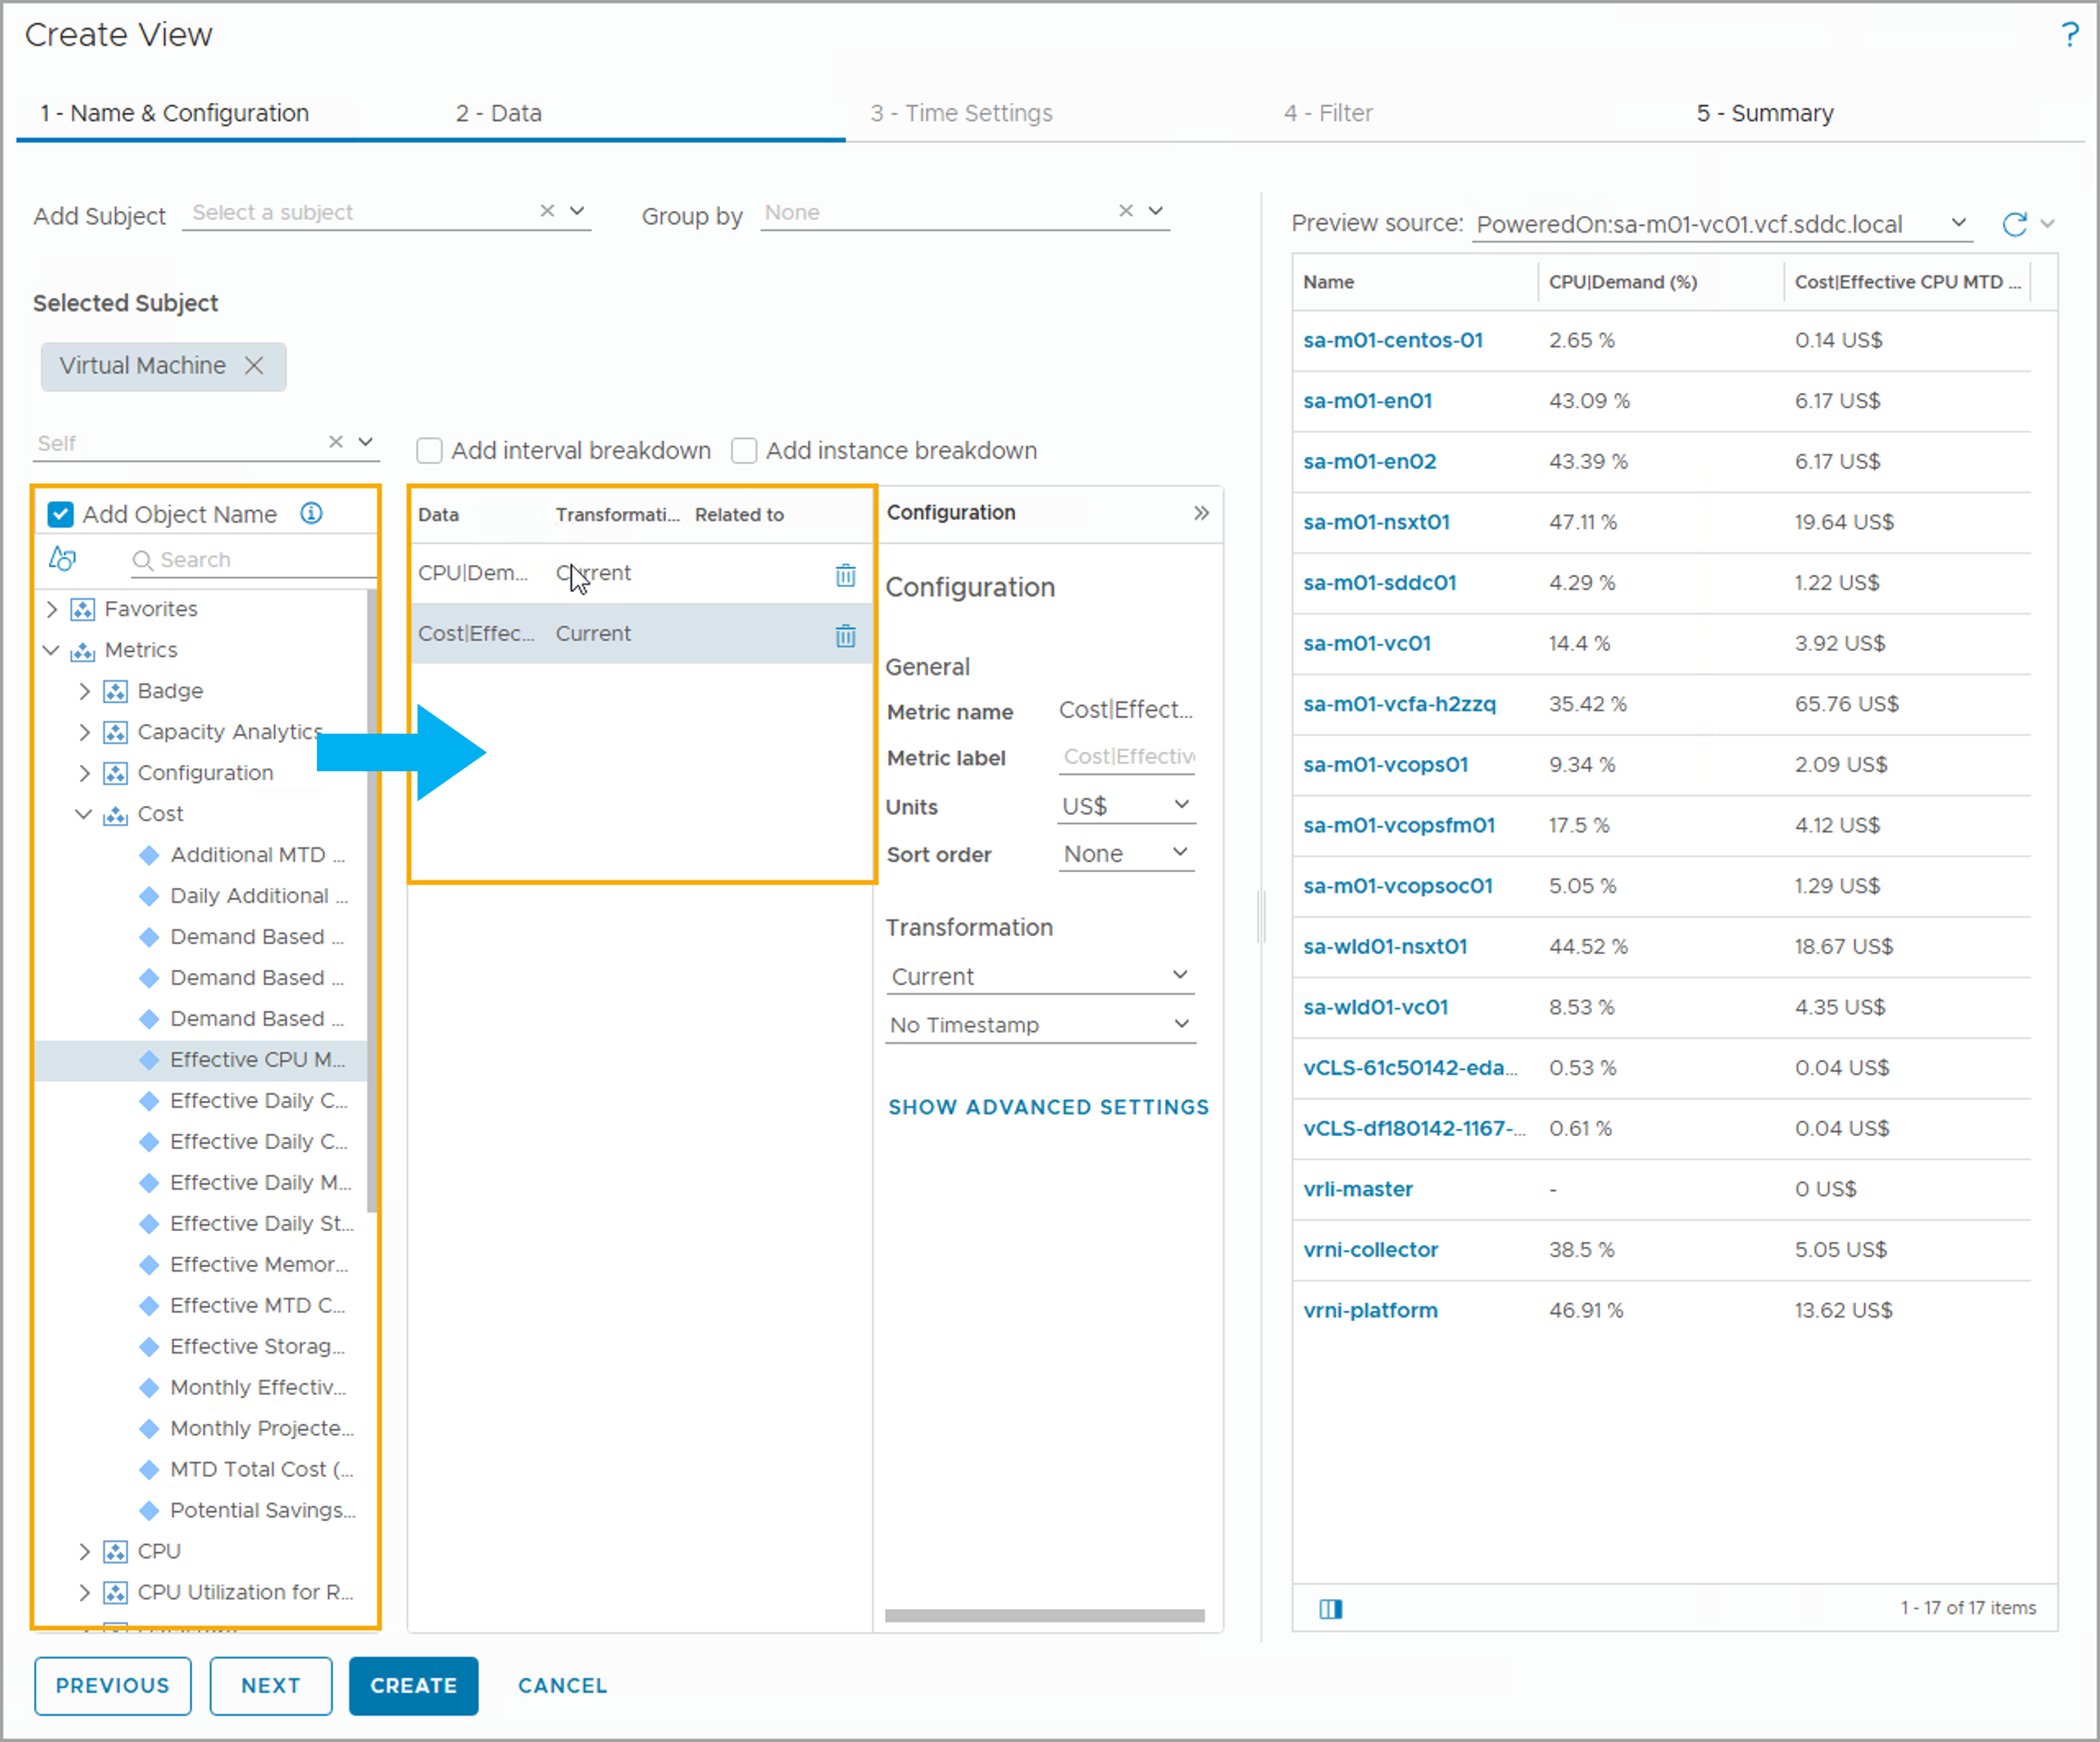
Selecting Data Subjects
After you select the data subjects, you need to define the data that VCF Operations collects, calculates, and presents in the view.
When defining data, you can include:
Properties
Metrics
Policies
Adapter-provided data
To add any data, you need to drag the data from the available data list into the view data area.
Notes:
TalkTrack:
This slide builds upon the previous step of selecting data subjects by now focusing on "Selecting Data" that VCF Operations will collect, calculate, and present within your custom view. Once you have identified the primary subject for your view, the next crucial step is to define precisely what information about that subject you want to visualize. When configuring the data for your view, you have the flexibility to include various types of information. This can encompass properties, which are descriptive attributes of an object; metrics, which are quantitative performance measurements; policies, defining specific operational rules; and other adapter-provided data. As illustrated in the screenshot, to add any of this data to your view, you simply drag the desired items from the available data list on the left side of the interface into the main view data area. For example, as shown, you can drag a metric like "CPU Usage Percentage" from the metrics list for virtual machines into the view. It is important to note that the specific data configuration options will depend on both the view type you selected and the data type you choose. All these settings are universally available across all view types, ensuring consistent configuration capabilities.
<End>
The data configuration depends on the view and the data type that you select. Settings are available for all views.
In the screenshot, some of the metrics available for the virtual machine object appear. You can drag any metrics in the left pane to the right pane for inclusion in the view.
In the example, the CPU Demand and the Effective CPU Monthly Cost metrics were added to the data to include in the view section.

Slide 21
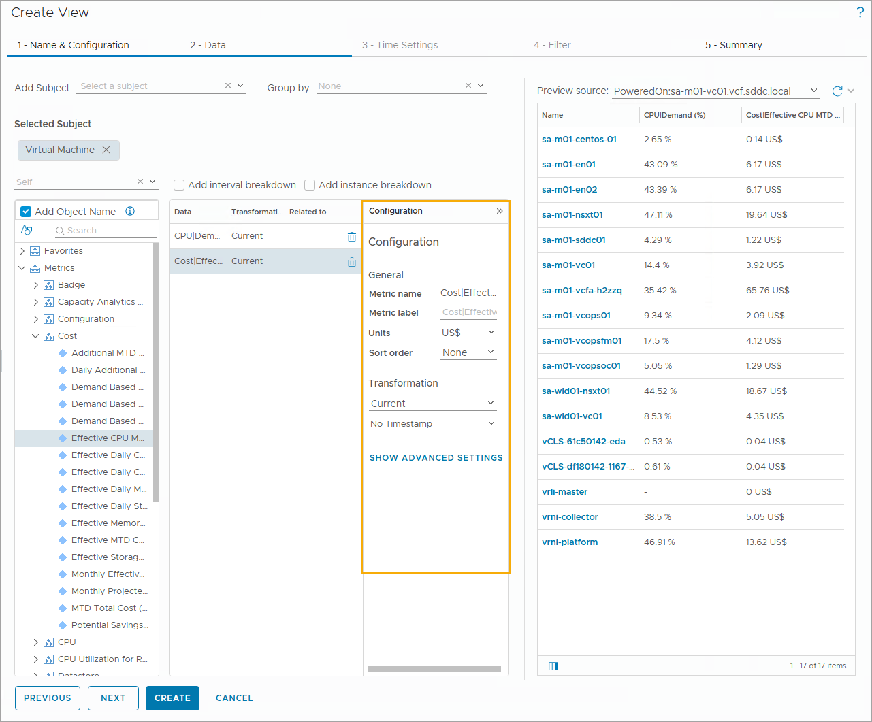
Configuring Data Metrics
For each metric that you drag to the data area, you can configure the general information, transformation type, and advanced settings.
Notes:
TalkTrack:
This slide focuses on "Configuring Data Metrics" within your custom view, providing granular control over how each metric is presented and calculated. For every metric that you drag into the data area of your view, you gain the ability to configure its general information, define its transformation type, and adjust advanced settings. Under the general information, you can specify a "Metric label," which is a user-defined name for the metric, helping to make the view more readable and understandable. You can also set the "Units" for the displayed values; this setting is dependent on the specific metric or property you have added. Choosing "Auto" for units allows the system to scale the values to a meaningful unit automatically. Furthermore, you can define the "Sort order" to organize the values in either ascending or descending order, which is useful for quickly identifying highs or lows. A powerful feature here is "Transformation," which determines the calculation method applied to the raw data collected for that metric. You can select a transformation type based on your specific analytical requirements, allowing you to derive more meaningful insights from the raw metric data. For example, you might apply a transformation to calculate an average over time, or a sum. These detailed configuration options ensure that each metric within your custom view provides the precise data presentation and analysis you need.
<End>
Configure the general information for each metric that you want to use in the view:
Metric label: User-defined name for the metric.
Units: Depends on the added metric or property. You can select the unit to display the values. If you select Auto, the scaling is set to a meaningful unit.
Sort order: Organizes the values in ascending or descending order.
Transformation determines the calculation method applied on the raw data. You can select the type of transformation based on your requirements.

Slide 22
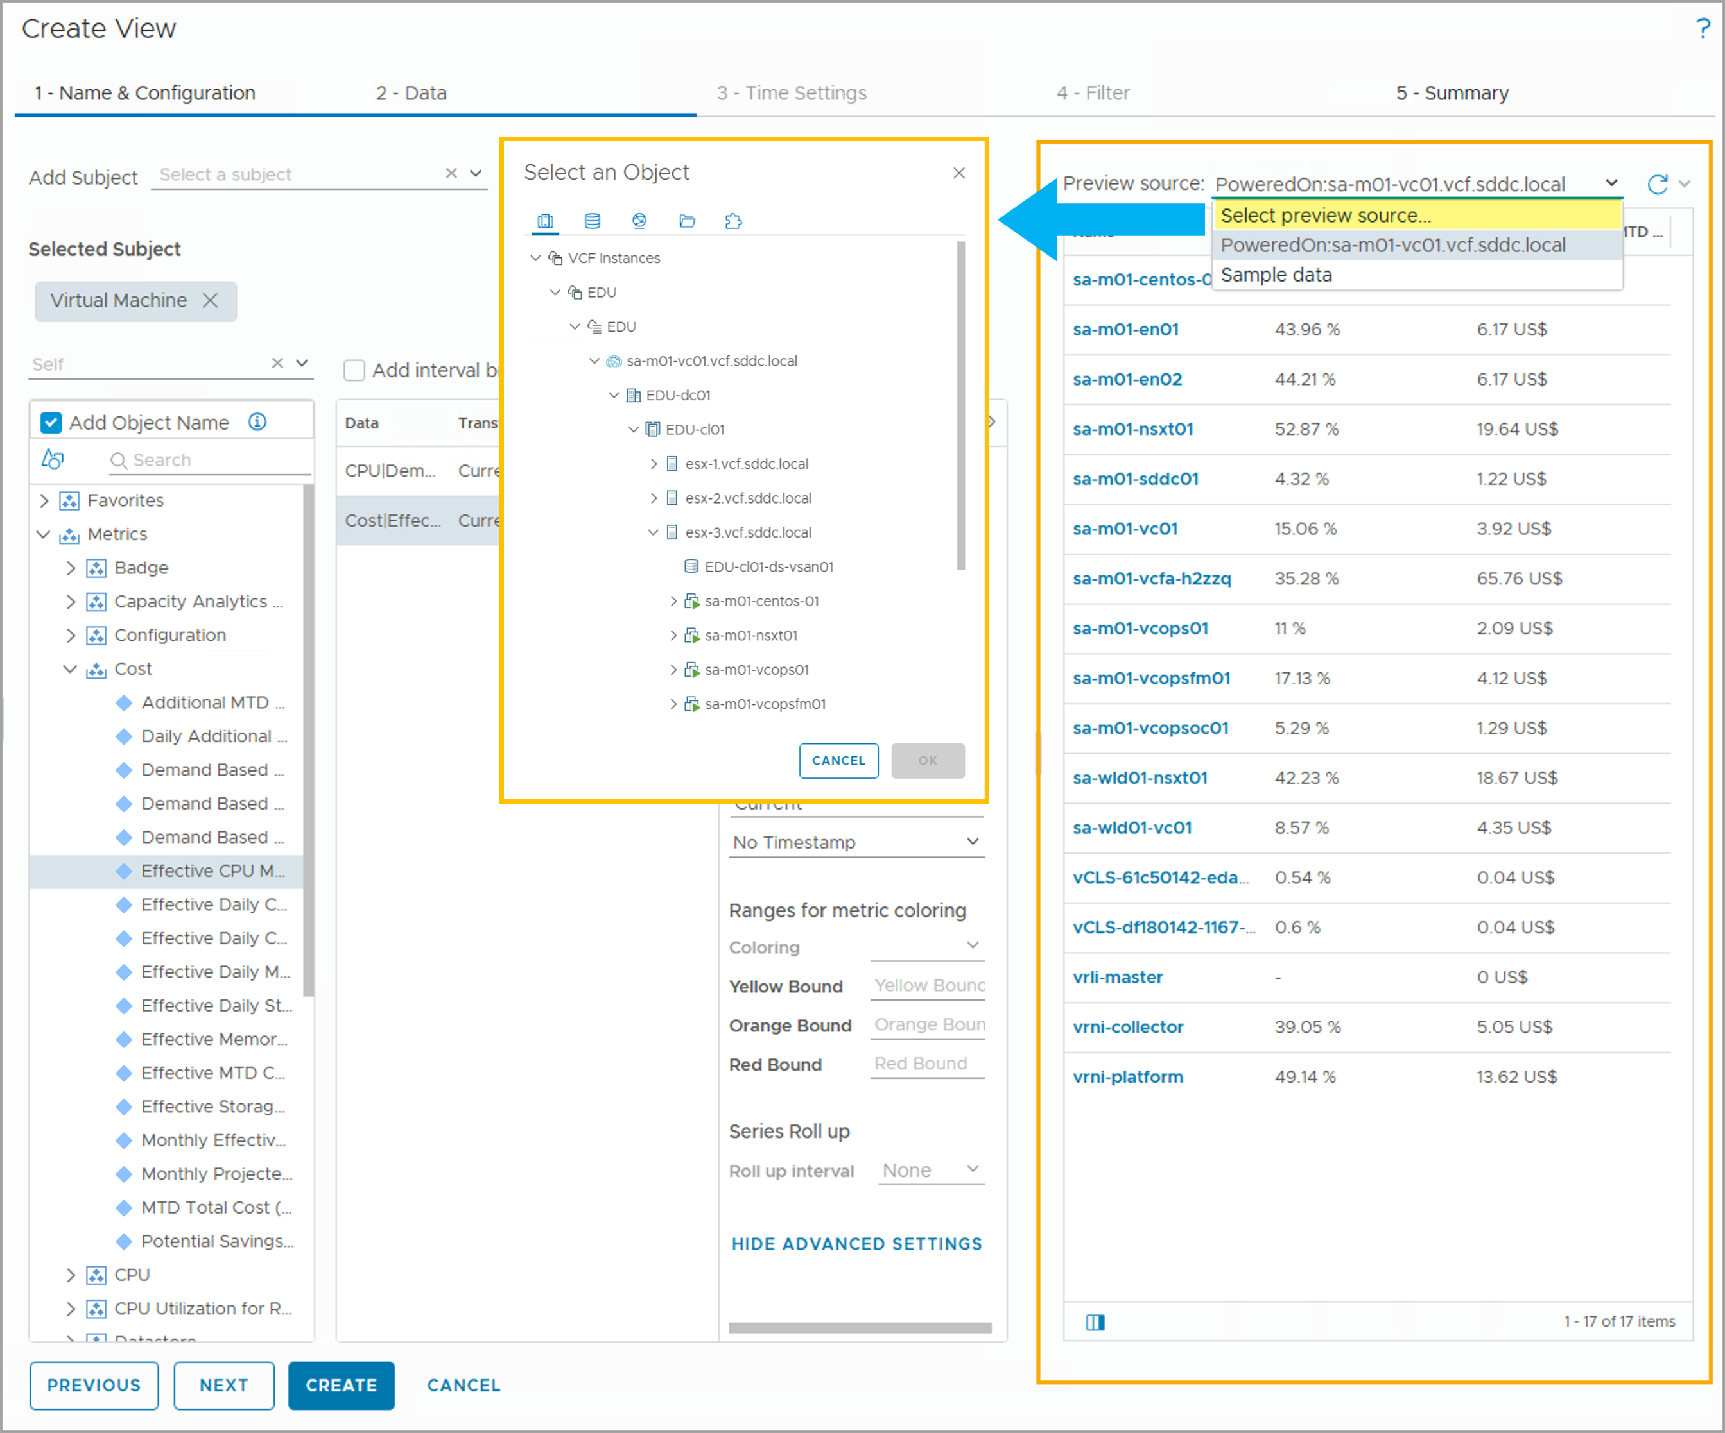
Previewing a View
You can preview a view with sample data or live data. To preview the view with live data, you select the subject or a container in which the subject exists.
Notes:
TalkTrack:
This slide covers an important step in the custom view creation process: "Previewing a View". As you configure your view, VCF Operations provides the capability to preview its output using either sample data or live data from your environment. This allows you to validate your configuration and ensure the view displays the information as intended before finalization. To preview your view with live data, you need to select a specific subject or a container where the subject exists. This is typically done on the "2 - Data" tab of the Create View wizard. Once a subject and relevant end data are selected, you can click "Select preview source" to populate your view with real-time information. Furthermore, if you make any changes to the view's configuration, such as altering a metric's sort order from descending to ascending, you can immediately see the effect of these changes by clicking the "Refresh" icon within the preview. The example provided illustrates testing a view configuration by observing live data, which is crucial for verifying that all selected metrics, properties, and their configurations are working as expected to deliver the desired operational insights.
<End>
When you create a view, you can see a preview of your view with sample data or live data. To see live data in your view, you select a subject and data and click Select preview source. You can also refresh the data in your view by clicking the Refresh icon. For example, if you change a metric’s sort order from ascending to descending, you can view the result by refreshing the preview of your view.
In the example, you test your view configuration by viewing live data.

Slide 23
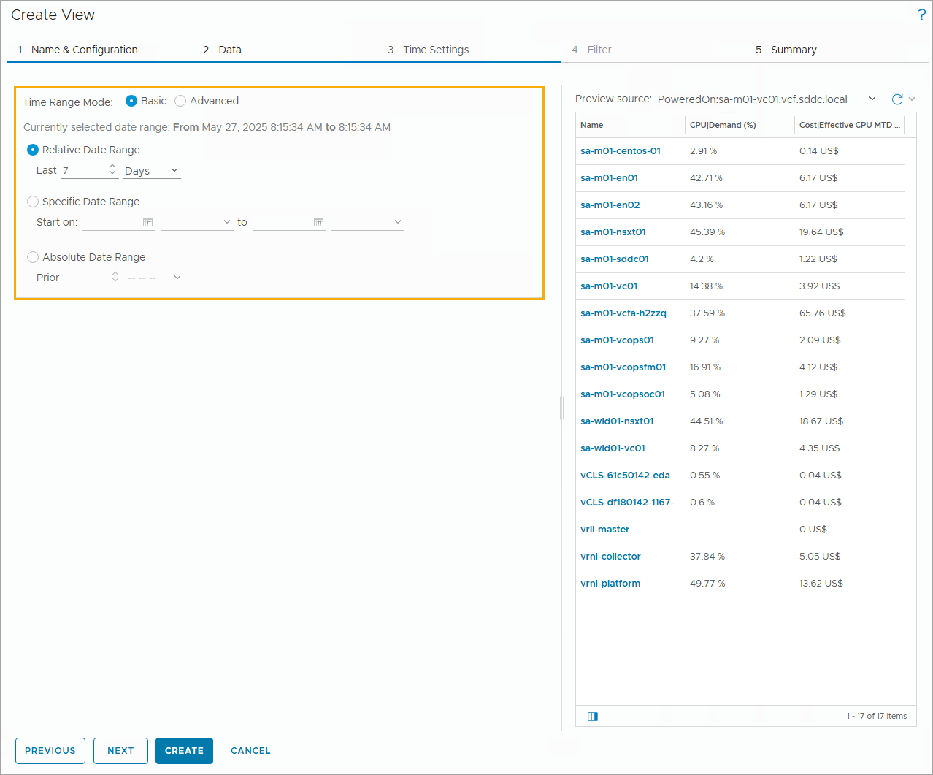
Configuring Basic Time Settings
Use the time settings to select the time interval of data transformation. These options are available for all view types, except Image.
In Basic mode, you can select date ranges. You can set a time range for a past period or set a future date for the end of the time period.
When you select a future end date and no data is available, the view is populated by forecast data. Data is collected based on the browser time.
Notes:
TalkTrack:
This slide focuses on "Configuring Basic Time Settings," which is the third step in creating a custom view. These settings are crucial for defining the time interval over which data transformation occurs and how data is displayed in your view. It is important to note that these options are available for all view types, with the exception of the Image view. In "Basic" mode, you can select specific date ranges, allowing you to set a time range for a past period to analyze historical data, or you can define a future date for the end of the time period to view forecasts. When a future end date is selected and no actual data is yet available for that period, the view will be intelligently populated with forecast data, providing predictive insights. Data collection for these views is based on the browser's current time. Alternatively, you can utilize the "Absolute Date Range" mode to display data for fixed time units, such as an entire month or a week. For instance, you could configure a report to run on the third of every month, showing data for the previous month. The display will then show data from the first to the end of the previous month, as compared to data from the third of the previous month up to the third of the current month. It's worth noting that the locale settings of your system will determine the precise start and end of these time units; for example, weeks typically begin on Monday in most European countries, while in the United States, they commonly start on Sunday. These time settings provide powerful control over the temporal scope and analytical depth of your custom views.
<End>
Use Absolute Date Range to view data for a time unit such as a complete month or a week. For example, you can run a report on the third of every month for the previous month. Data from the first to the end of the previous month is displayed as against data from the third of the previous month to the third of the current month. The locale settings of the system determine the start and end of the unit. For example, weeks in most of the European countries begin on Monday while in the United States they begin on Sunday.

Slide 24
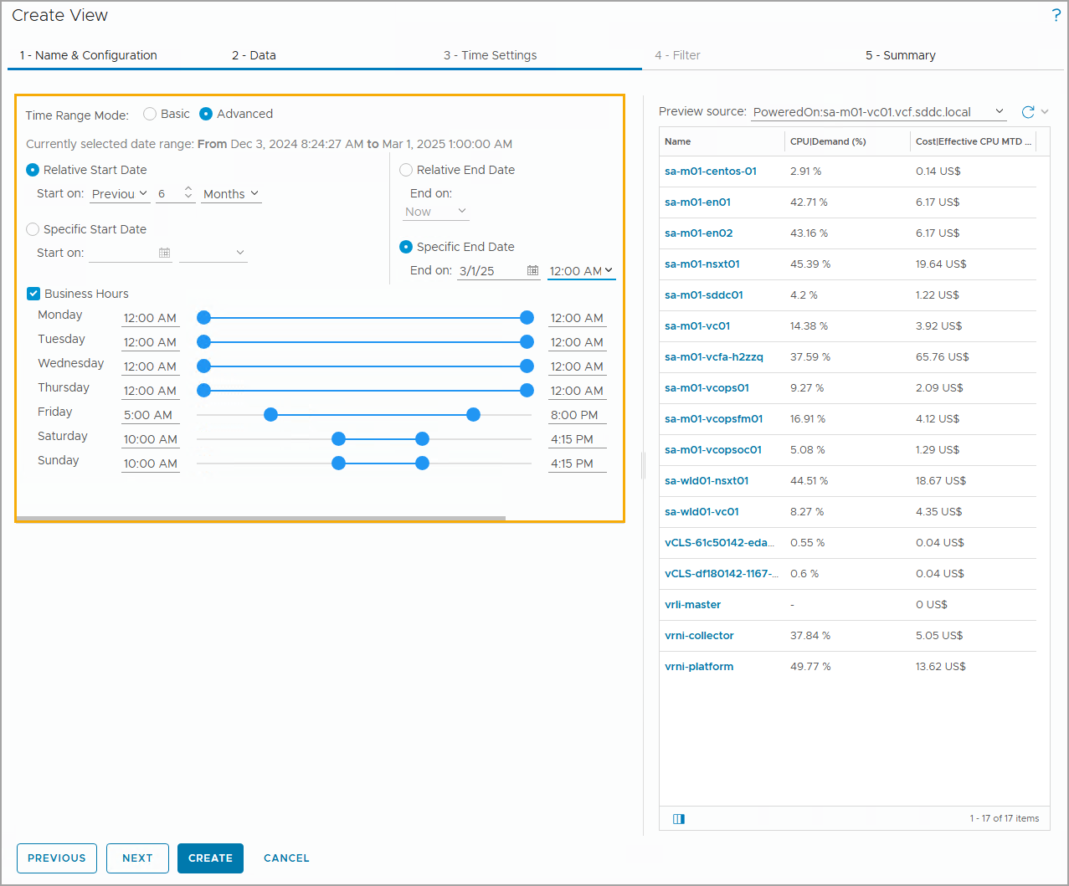
Configuring Advanced Time Settings
In Advanced mode, you can select any combination of relative or specific start and end dates.
To preview the view with live data, you select the subject or a container in which the subject exists.
Notes:
TalkTrack:
This slide delves into "Configuring Advanced Time Settings" for your custom views, offering a much more granular control over the time intervals for data display. In "Advanced mode," you gain the flexibility to select any combination of relative or specific start and end dates, allowing for highly customized temporal analysis. Similar to the basic mode, you can still preview your view with live data by selecting the relevant subject or its containing object. The power of advanced time settings becomes evident when you need to focus on specific operational periods, such as business hours. As illustrated in the screenshot, you can precisely select business hours from Monday through Sunday by manipulating the sliders on both the left and right sides of the interface. These sliders allow you to set the exact start and end times for each day of the week. For example, if you are a virtual machine owner, this feature enables you to track the average utilization of virtual machines specifically during business days and within predefined business hours. This advanced time configuration is particularly useful and available when applying transformations such as Minimum, Maximum, Average, Sum, and Percentile, providing more precise insights into resource behavior during critical operational windows.
<End>
Select business hours from Monday to Sunday by moving the sliders on the left and right sides to set the start and end time for each day of the week. For example, as a VM owner, you can track the average utilization of VMs over a week (business days), during specified hours of the day (business hours). This option is available for Minimum, Maximum, Average, Sum, and Percentile transformations.

Slide 25
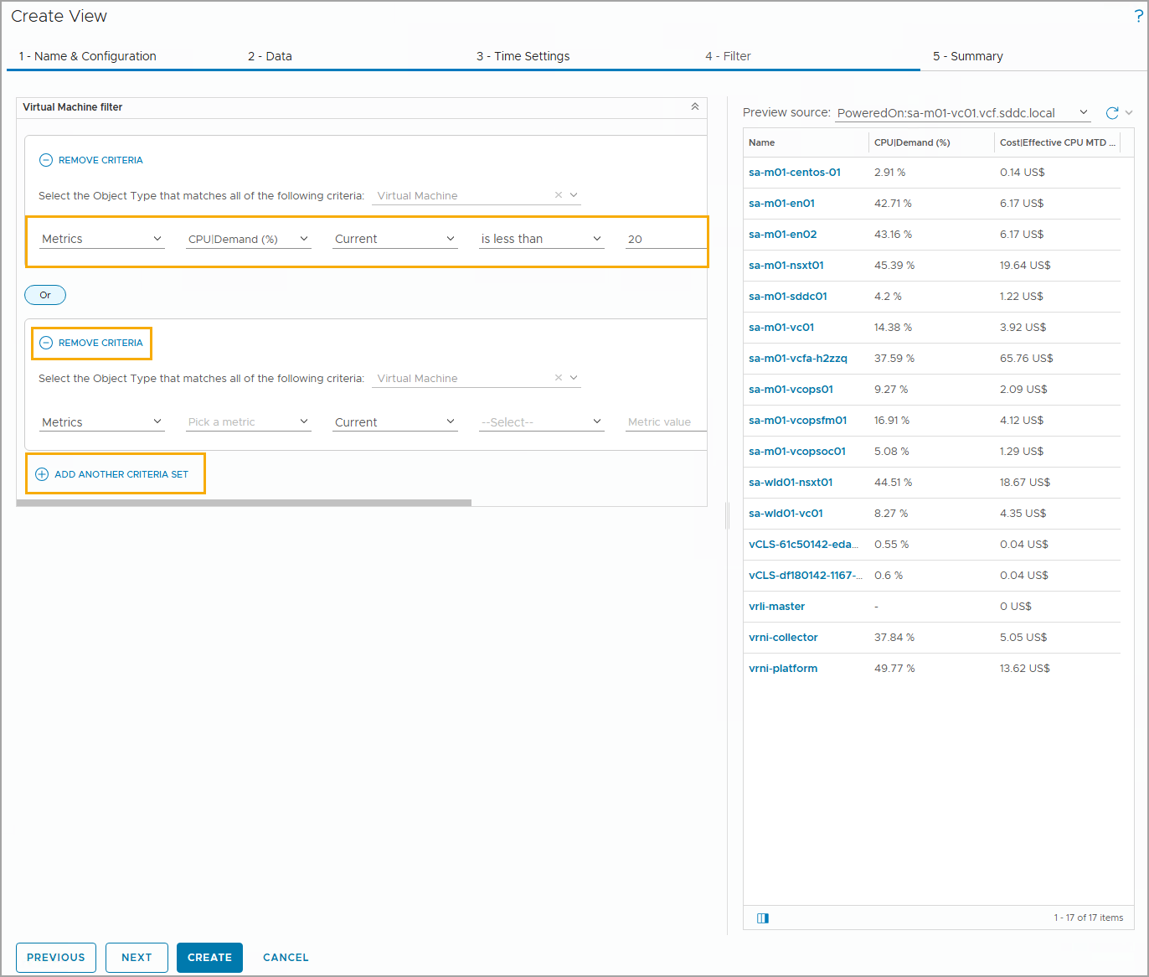
Configuring a Data Filter
The filter option allows you to add additional criteria when the view displays too much information.
You can filter based on object metrics and object properties. To configure a data filter, you need to specify the data type, the data, the data value (historical high/low or timestamp), the logical operator, and a reference value.
You can add multiple criteria to the criteria set. The filter returns results that match all the specified criteria.
Notes:
TalkTrack:
This slide focuses on "Configuring a Data Filter," which is the fourth step in creating a custom view and is crucial for refining the data displayed. The filter option provides the ability to add additional criteria, which is particularly useful when your view initially presents too much information or when you need to focus on specific subsets of data. You can apply filters based on both object metrics and object properties. To configure a data filter, you need to specify several elements: the data point you want to filter (for example, a metric like CPU Demand Percentage), the specific data value you are interested in (which can include historical high or low instances), a logical operator (such as "less than" or "greater than"), and a comparison value. The system allows you to add multiple criteria to your filter set; when you do so, the view will only return results that match all the specified criteria, enabling very precise data segmentation. For instance, if you have a list view showing the health of virtual machines, you could go to the filter tab and add a criterion to display only those virtual machines where the CPU demand percentage is less than 10%. This would then filter the view to show only the virtual machines that meet this specific performance condition. For certain criteria, you can also specify business hours, ensuring that filters are applied contextually to operational periods. Just like with other view configurations, you can refresh the data in your view's preview by clicking the refresh icon to immediately see the impact of your filter changes.
<End>
For example, a list view shows information about the health of virtual machines. On the Filter tab, you add a CPU demand percentage metric less than 15%. The view displays the health of all virtual machines with CPU demand less than 15%. For selected criteria you can also apply Business Hours, if the selected transformation type you add as a filter is supported by the business hours functionality.
You can also refresh the data in your view by clicking the Refresh icon. For example, if you change a metric’s sort order from ascending to descending, you can view the result by refreshing the preview of your view.

Slide 26
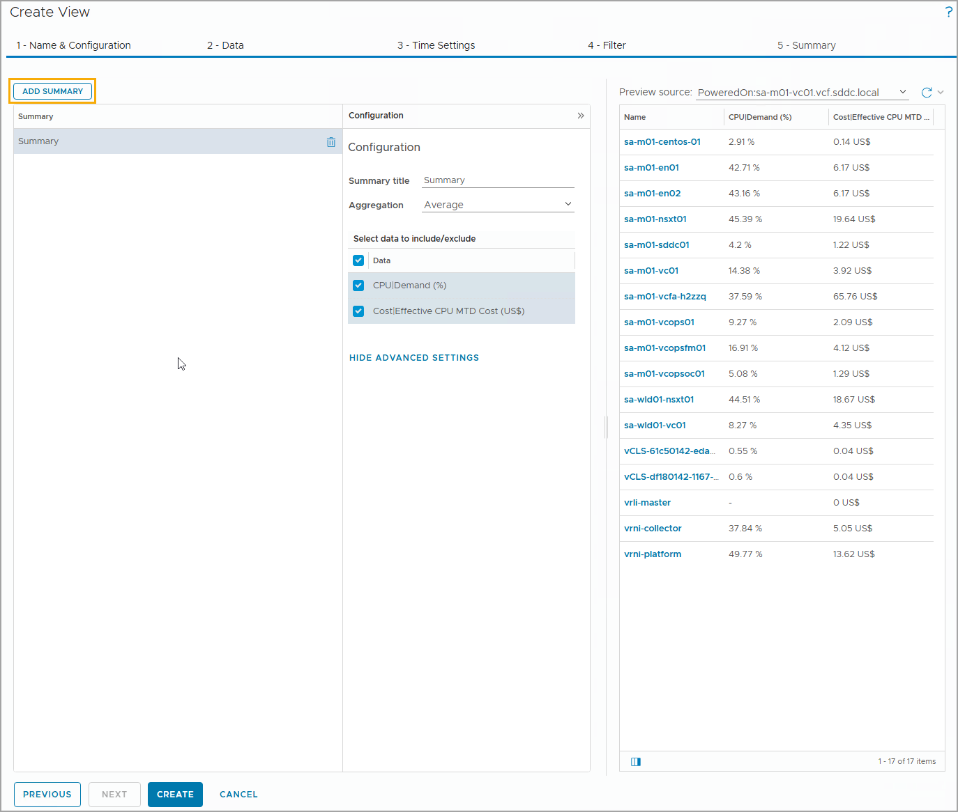
Adding a View Summary
You can add more than one summary row or column and configure each to show different aggregations.
Notes:
TalkTrack:
This slide covers the final step in creating a custom view: "Adding a View Summary," which is configured on the "5 - Summary" tab of the Create View wizard. This feature allows you to add one or more summary rows or columns to your view, and each can be configured to display different aggregations of your data. In the Summary configuration panel, you will select the aggregation method that best suits your needs, such as "Average," "Sum," "Minimum," or "Maximum". You also define precisely what data should be included or excluded from these summary calculations. For example, as shown in the screenshot, you can choose to include metrics like "CPU Demand" and "CostEffective CPU Monthly Cost" in your summary calculations, applying an aggregation method like "Average" to them. This capability is invaluable for providing quick, high-level insights into your data, allowing you to see aggregated performance or cost figures at a glance without having to analyze all the raw data points. Once these summary settings are configured, you can then proceed to create and save your custom view.
<End>
In the summary configuration panel, you select the aggregation method and what data to include or exclude from the calculations.

Slide 27
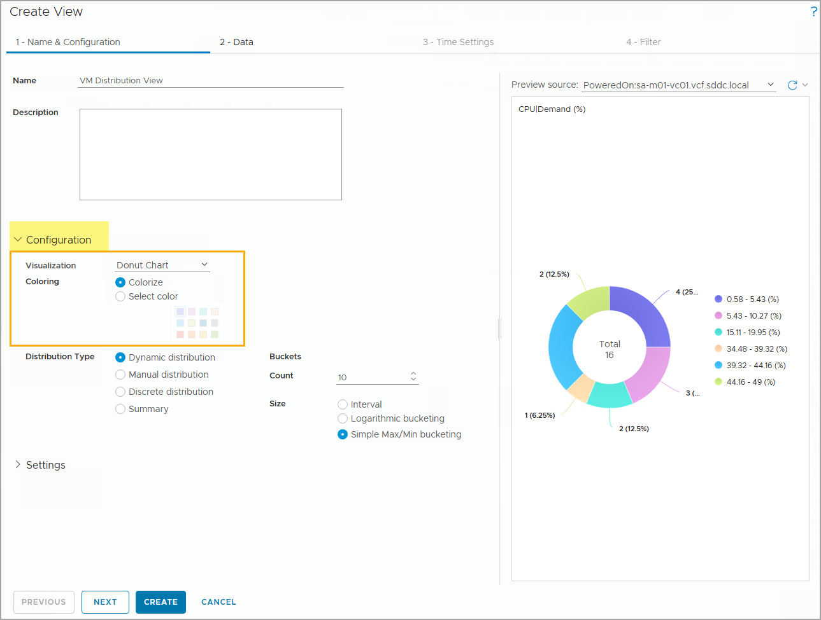
Distribution View Configuration: Visualization
For the Distribution view, you create a pie chart, a bar chart, or donut chart, and specify the Distribution Type. It determines the distribution of objects to buckets.
The colors of the slices in a pie or donut chart appear in the order defined by the default color palette. You can set alternative colors for the chart.
Notes:
TalkTrack:
This slide focuses on the "Distribution View Configuration" and its visualization options, which is a specific type of view available in VCF Operations. When creating a distribution view, your primary goal is to visualize how objects are distributed into various buckets based on a chosen metric. To achieve this, you can select from several chart types: a pie chart, a bar chart, or a donut chart. You also specify the "Distribution Type," which governs how objects are categorized and assigned to these buckets. The colors used for the slices in a pie or donut chart follow the order defined by the default color palette. While the system provides an automatic coloring scheme, you can also set a narrative color for your chart to emphasize specific aspects. When you integrate a distribution view into a dashboard, for instance, to view a list of objects, you can click a section of the chart, be it a pie slice, bar, or donut segment, to view a filtered list of objects that fall within that selected segment. In cases where a donut chart has more than one slice, the colors are sequentially assigned from the palette; for bar charts, all bars will typically share the same color. Beyond viewing, VCF Operations also provides robust reporting functions that leverage these views. You can generate comprehensive reports to capture details about current or predicted resource needs, and these reports can be downloaded in PDF or CSV file formats for future reference and offline analysis. The Reports page lists available report templates, which may vary depending on the object type selected.
<End>
You can view the data as a pie chart, a bar chart, or a donut chart. For example, when you add a distribution view to a dashboard for viewing the list of objects, click (highlight) a section of the chart (pie, bar, or donut) to view the list of objects filtered based on the selected segments. Using the Distribution view, you create buckets. Based on a certain metric, fill those buckets with objects.
With the VCF Operations reporting functions, you can generate a report to capture details about the current or predicted resource needs. You can download the report in a PDF or CSV file format for future and offline needs.
The Reports page lists the available report templates. Different object types might have different report templates. The example on the slide shows some of the available predefined report templates.
If more than one slice exists in a donut chart, the colors are selected sequentially from the color palette. In a bar chart, the bars have the same color.

Slide 28
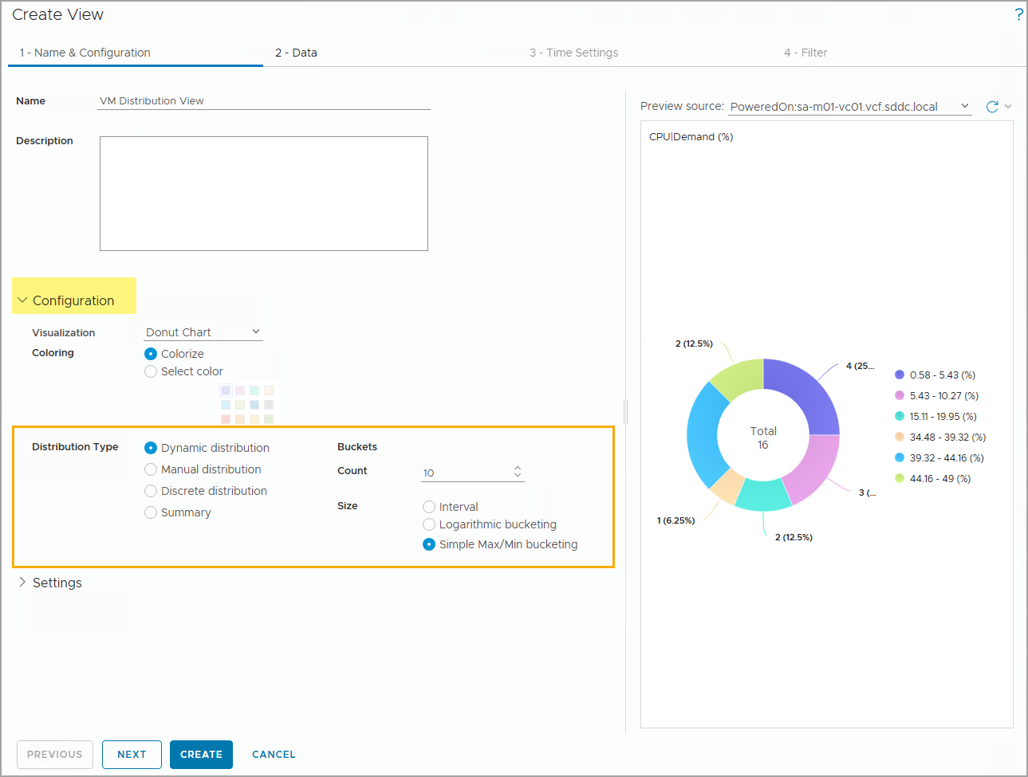
Distribution View Configuration: Distribution Type
The VCF Operations view distribution type provides aggregated data about resource distribution in the monitored environment.
Notes:
TalkTrack:
This slide elaborates on the "Distribution View Configuration," specifically focusing on the "Distribution Type," which defines how VCF Operations aggregates and presents resource distribution data within your environment. This view type is designed to provide aggregated insights into how your resources are spread across different categories or ranges. When configuring a distribution view, you specify in detail how VCF Operations distributes the data into buckets. You can choose from several distribution types: The "Dynamic distribution" option uses an algorithm to automatically determine both the number of buckets and how objects are distributed within each bucket. Within dynamic distribution, you have further sub-options for defining bucket sizes: "Buckets Size Interval" where the size is determined by a defined interval divided by the specified number of buckets, "Buckets Size Logarithmic bucketing" which uses an internal algorithm for calculation, and "Buckets Size Simple Max and Min bucketing" where the bucket size is equally divided across the measured minimum and maximum values, ensuring continuous coverage of the data range. Alternatively, "Manual distribution" allows you to precisely determine the number of buckets and specify which objects are added to each. Finally, "Discrete" distribution places every object into its own individual bucket, providing the most granular view of distribution. These options allow you to tailor the resource distribution analysis to your specific requirements, whether you need a high-level overview or a detailed breakdown.
<End>
You specify in detail how VCF Operations distributes the data in the buckets.
To configure the Distribution view, you can select the following distribution types:
Dynamic: VCF Operations uses an algorithm that automatically determines the number of buckets and the distribution of objects in each bucket. The Dynamic view appears when you manage the following varying data values.
Buckets Count: Number of buckets to use in the data distribution.
Buckets Size Interval: The bucket size is determined by the defined interval divided by the specified number of buckets.
Buckets Size Logarithmic bucketing: The bucket size is calculated by using an internal algorithm.
Buckets Size Simple Max and Min bucketing: The bucket size is divided equally between the measured minimum and maximum values. This provides continuous coverage of the complete range with the specified number of buckets.
Manual: You determine the number of buckets and objects to add to each bucket.
Discrete: Every object is placed in its own bucket.

Slide 29
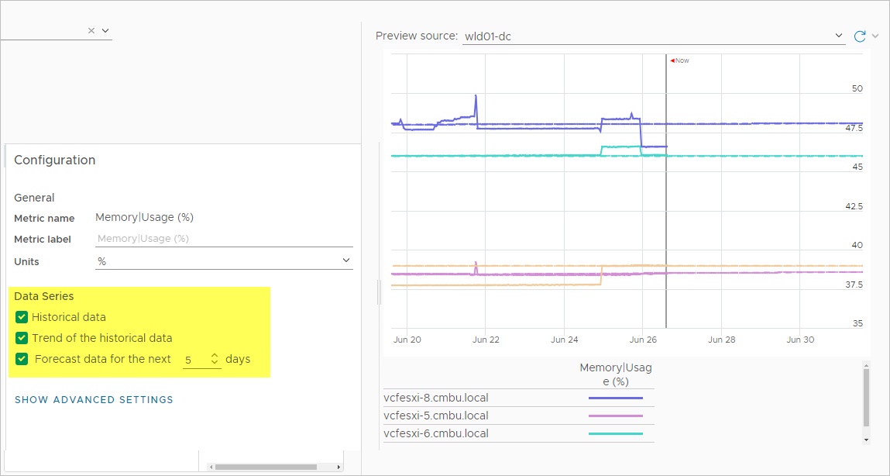
Trend View Configuration
The Configuration pane for a view is specific to the type of view that you select. To configure a Trend view, you specify whether you want to use the historical data, forecast data, or both.
Notes:
TalkTrack:
This slide focuses on the "Trend View Configuration," highlighting how to set up this specific type of view in VCF Operations. As we've discussed, the configuration options for a view are tailored to its type. For a Trend view, your primary decision involves specifying whether you want to display historical data, forecast data, or a combination of both. Historical data refers to past metrics and events related to a particular object or group of objects, providing a retrospective look at performance. Forecast data, on the other hand, represents predictions derived from analyzing historical patterns and recent behavior of objects. In the Trend view, you can choose to include historical data, show the trend of that historical data, and even project forecast data for a specified number of days into the future, such as the next five days. As depicted in the example, the view shows a trend of ESXi host memory usage over time, drawing its data from the "Memory Usage (%)" metric for the selected data center preview source. In such a visualization, the solid lines on the graph represent the actual historical data, while any dotted lines indicate the projected or forecast data, offering a comprehensive view of past performance and future predictions.
<End>
Historical data is data about past metrics and events for a particular object or group of objects. Forecast is a prediction made by studying historical data including past patterns and recent behavior of objects. In the Trend view, you can select whether to include historical data, trend of the historical data, and forecast data for the next 5 days.
In the example, the view is a trend view, which gets its data from the ESXi host Memory Usage (%) metric for the selected data center preview source. The result is a trend of the ESXi host memory usage over time. The solid lines represent historical data, and the dotted lines represent projected data.

Slide 30
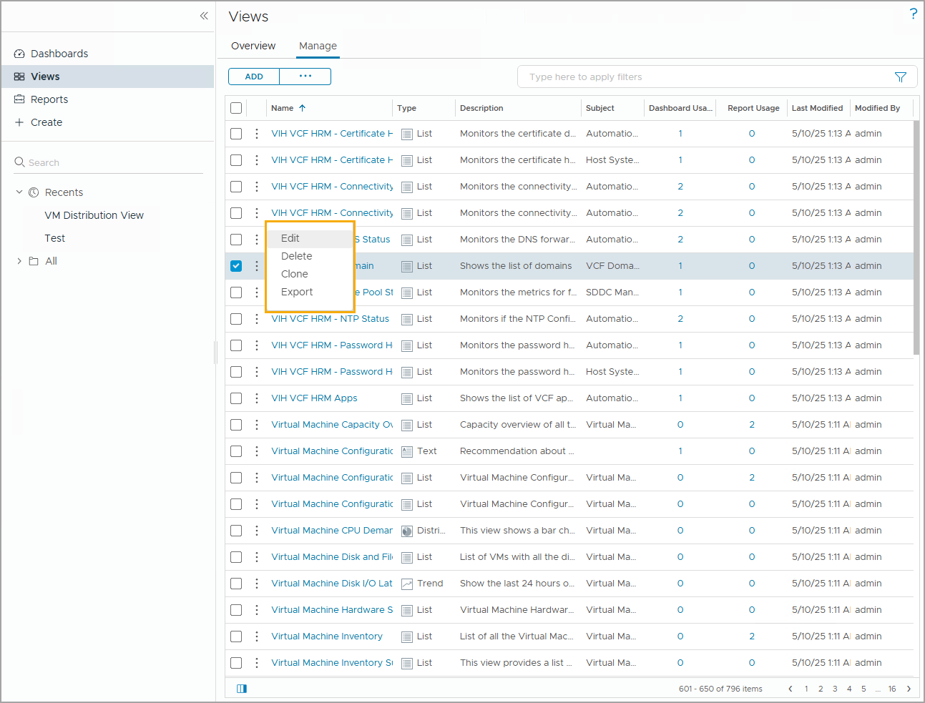
Managing Views
You can perform the following actions on views:
Edit a view: When you edit a view, all changes are applied to report templates that contain the view.
Delete a view: When you delete a view, the view is removed from all the report templates that contain the view.
Clone a view: When you clone a view, the changes that you make to the clone do not affect the source view.
Export a view: You can download and share the view configuration details in a ZIP file.
Notes:
TalkTrack:
This slide transitions from creating custom views to "Managing Views" within the VCF Operations console, outlining the various actions you can perform on views once they have been created. It is crucial to understand the implications of each action before proceeding. Firstly, you have the option to "Edit a view". When you make changes to an existing view, all these modifications are automatically applied to any report templates that currently contain that view. This ensures consistency across your monitoring and reporting. Secondly, you can "Delete a view". If you choose to delete a view, it will be removed from all report templates that use it. Thirdly, the "Clone a view" function allows you to create a duplicate of an existing view. The key benefit here is that any changes you make to the cloned view will not impact the original, or source, view. This is excellent for testing new configurations without altering your production views. Lastly, you can "Export a view". This action enables you to download and share the view's configuration details, typically in a ZIP file format. This export capability is useful for backup purposes, migrating views between environments, or sharing specific view configurations with other teams.
<End>
Note: Before you perform these actions, you must be familiar with the consequences of these actions. When you edit a view, all the changes are applied to the view templates that contain the view.

Slide 31
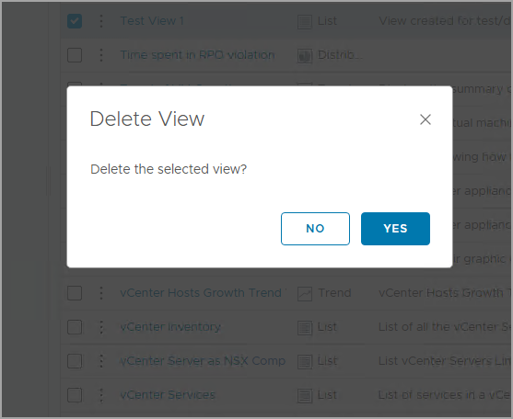
Deleting a View
When a view is deleted, several areas in the user interface are affected:
Report templates: The view is removed from the report template.
Dashboards: The View widget appears. The view does not exist.
Further Analysis pane on the Analysis tab: The link to the view is removed.
Views tab for the selected object: The view is removed from the list.
Notes:
TalkTrack:
This slide specifically addresses "Deleting a View," an important management action within VCF Operations that requires careful consideration. When a view is deleted, it has several cascading effects across the user interface that you must be aware of. Firstly, the deleted view is removed from any report templates that currently include it. If the view was part of a dashboard, the associated view widget will appear, but the underlying view itself will no longer exist, indicating a broken link. Similarly, any links to the deleted view within the "Further Analysis" pane on the Analysis tab will be removed. Lastly, and most directly, the view will be removed from the list on the Views tab for any selected object. Therefore, before proceeding with the removal of a view, it is always recommended to consider the full impact on other components and to confirm that the expected outcomes align with your intentions.
<End>
Before removing a view, you should always consider the impact to other components, and confirm the expected outcomes.

Slide 32
Lab: Creating a Custom View
Create a view to display the VM information:
Create a View that Provides the VM Configuration Details
Define the Data to Include in the VM Configuration Details View
Preview Live Data in the VM Configuration Details View
Add a Summary Row to the VM Configuration Details View

Slide 33
Review of Learner Objectives
Outline the role of views in VCF Operations
Create a basic custom view and configure view settings

Slide 34
Viewing and Managing Reports

Slide 35
Learner Objectives
Outline the roles of reports in VCF Operations
Create a basic report and configure report settings
Create a custom report template

Slide 36
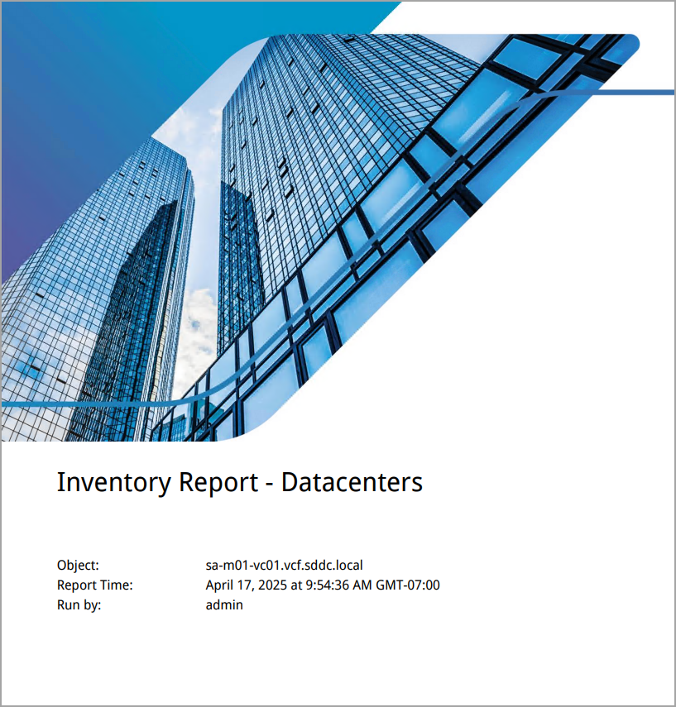
Understanding Reports
With the VCF Operations reporting functions, you can generate a report to capture details about the current or predicted resource needs.
A report is a scheduled snapshot of views and dashboards. Reports represent objects and metrics and can also contain a cover page, table of contents, and footer.
You can download the report in a PDF or CSV file format for future and offline needs.
Notes:
TalkTrack:
This slide introduces "Understanding Reports" in VCF Operations, a critical function for capturing and disseminating operational status information. With the robust reporting capabilities available, you can generate detailed reports that capture current or predicted resource needs across your environment. Essentially, a report is a scheduled snapshot of views and dashboards that you have configured. These reports represent specific objects and their associated metrics, and they can be comprehensive documents that include a cover page, a table of contents, and a footer for professional presentation. For convenience and offline access, you have the flexibility to download these reports in either PDF or CSV file formats. Reports are particularly useful for saving time when you need to provide periodic operational status updates to stakeholders. While VCF Operations offers a variety of predefined report templates to get you started, you also have the flexibility to build your own custom report templates to meet specific organizational requirements.
<End>
Reports can save time when you must send the periodic operational status information. Predefined report templates are available. You can also build your own report templates.

Slide 37
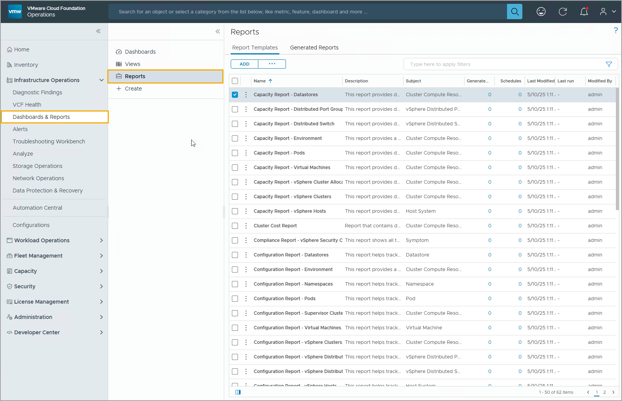
Report Templates
A report template is a predefined container of one or more views in a specified order. You can access the report templates under Infrastructure Operations > Dashboards & Reports > Reports.
Notes:
TalkTrack:
This slide provides further detail on "Report Templates" within VCF Operations, building upon our understanding of reports. A report template serves as a predefined container that organizes one or more views in a specific, predetermined order. These templates standardize how your data is presented and can be accessed within the console by navigating to "Infrastructure Operations" then "Dashboards & Reports" and finally "Reports". The "Report Templates" tab will display all templates that are applicable for the object you have selected. This allows for contextual reporting based on the entities you are managing. To help you locate and manage templates efficiently, you have various sorting options. You can sort the templates by their name, description, the subject they pertain to, their last modified date, when they were last run, or even by the user who last modified them. This organizational flexibility ensures that you can quickly find and utilize the appropriate templates for your reporting needs.
<End>
All templates that are applicable for the selected object appear on the Report Templates tab. You can sort them by report name, description, subject, last modified date, last run, or by whom they were modified.

Slide 38
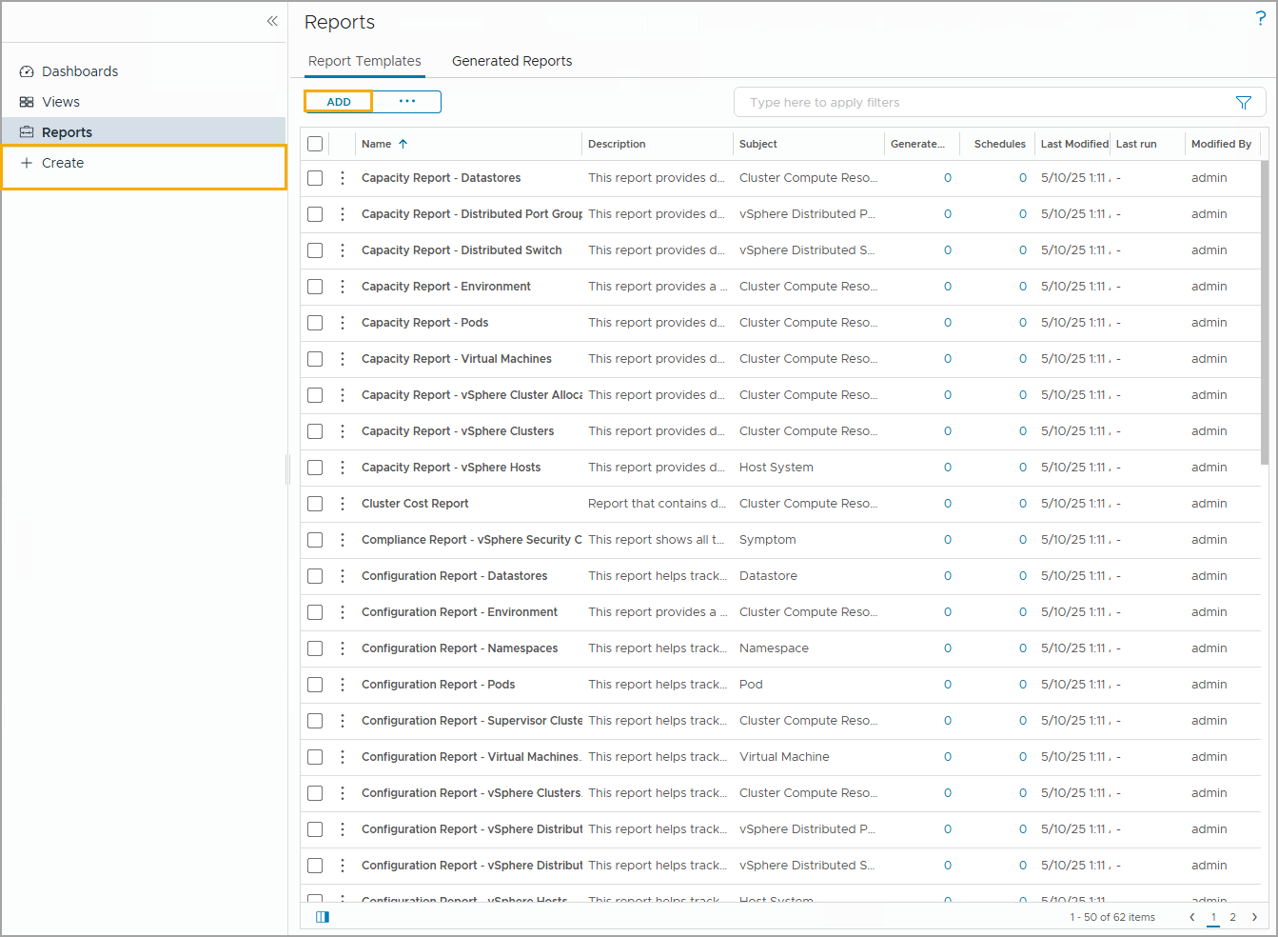
Creating a Report Template
You can create a custom report template based on your requirements. To add a custom template, click the ADD button or click + Create.
You need to complete the following tasks when creating a custom report template:
Setting name and description.
Adding views and dashboards.
Configuring layout and format.
Notes:
TalkTrack:
This slide guides us through the process of "Creating a Report Template" within VCF Operations, allowing you to build custom reports tailored to your specific needs. While predefined report templates are available, the ability to create your own provides significant flexibility. To begin creating a new custom template, you simply click the "ADD" button or the "+ Create" option within the Reports section. The process of creating a new custom report template involves completing three primary tasks. First, you will set the name and provide a description for your new report template, which helps in its identification and organization. Second, you will add the specific views and dashboards that you wish to include in your report. This allows you to combine various data visualizations and summaries into a single, cohesive document. Finally, you will configure the layout and format of the report, ensuring that the information is presented in a clear, professional, and easily consumable manner. These steps ensure that the generated reports meet your exact reporting requirements.
<End>

Slide 39
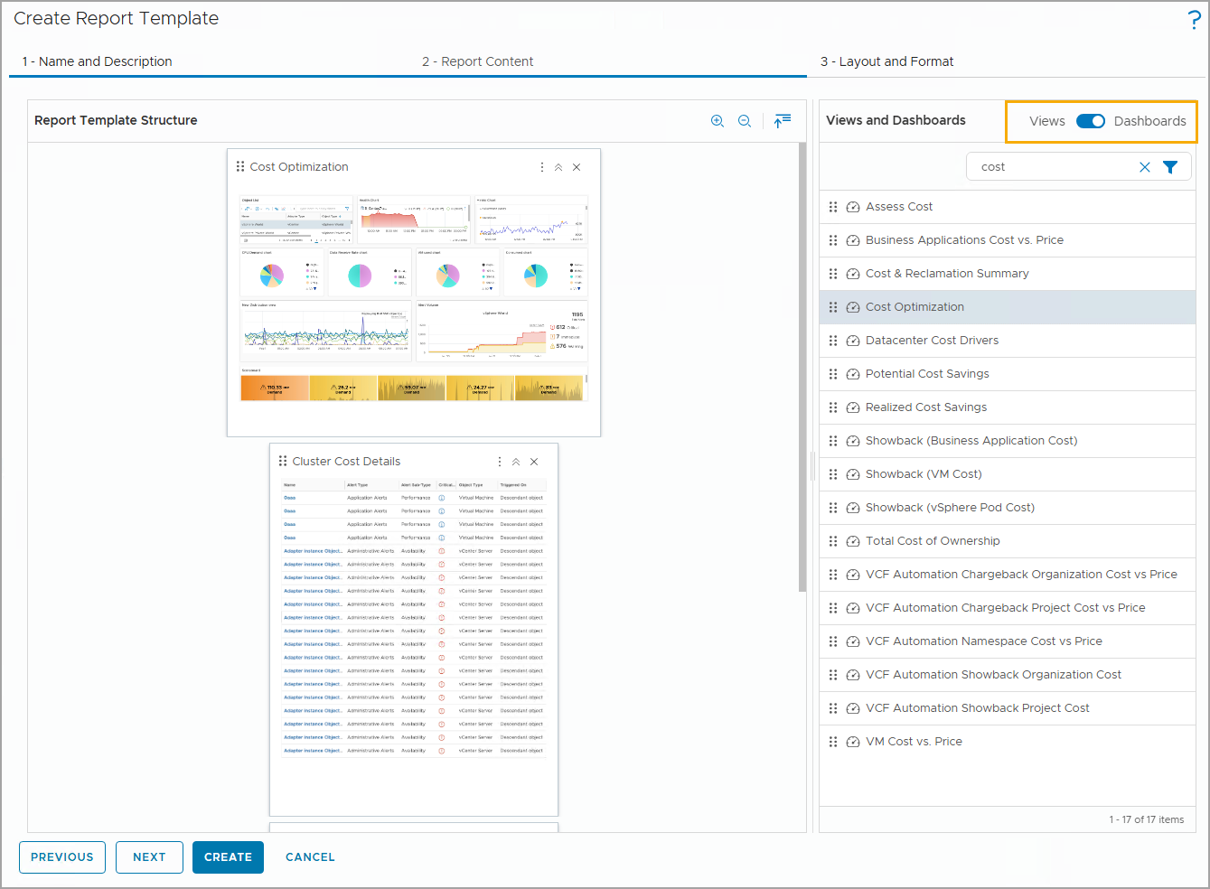
Adding Views and Dashboards to a Report Template
To add a view or a dashboard to your report template, select the view or dashboard from the list in the right pane and drag it to the main Report Template Structure pane.
You can use the Views and Dashboards toggle to switch between a list of views and a list of dashboards. You can add multiple views and dashboards to a single report template.
Notes:
TalkTrack:
This slide elaborates on the second step of creating a report template, focusing on "Adding Views and Dashboards to a Report Template". Views and dashboards are the core components that provide the data and visualizations within your reports. Views, as we've discussed, present collected information for a specific object, while dashboards offer a visual overview of the performance and state of objects across your virtual infrastructure. To incorporate a view or a dashboard into your report template, you simply select the desired item from the list in the right pane of the "2 - Report Details" tab and then drag it to the "Report template structure" pane on the left. A convenient toggle allows you to switch between the list of available views and the list of dashboards, giving you full flexibility. You can add multiple views and dashboards to a single report template, and you have the ability to order them as needed to create a cohesive and logical flow of information. For instance, the example shows a report template that combines a "Cost Optimization" dashboard with a "Cluster Cost Details" view, aiming to provide report viewers with insights into managing and optimizing costs across different clusters.
<End>
The report template contains views and dashboards. Views present the collected information for an object. Dashboards provide a visual overview of the performance and state of objects in the virtual infrastructure. You can combine different views and dashboards and order them for your needs.
In the example, the report template includes the Cost Optimization dashboard and the Cluster Cost Details view to provide report viewers insights about managing and optimizing cost for different clusters in the environment.

Slide 40
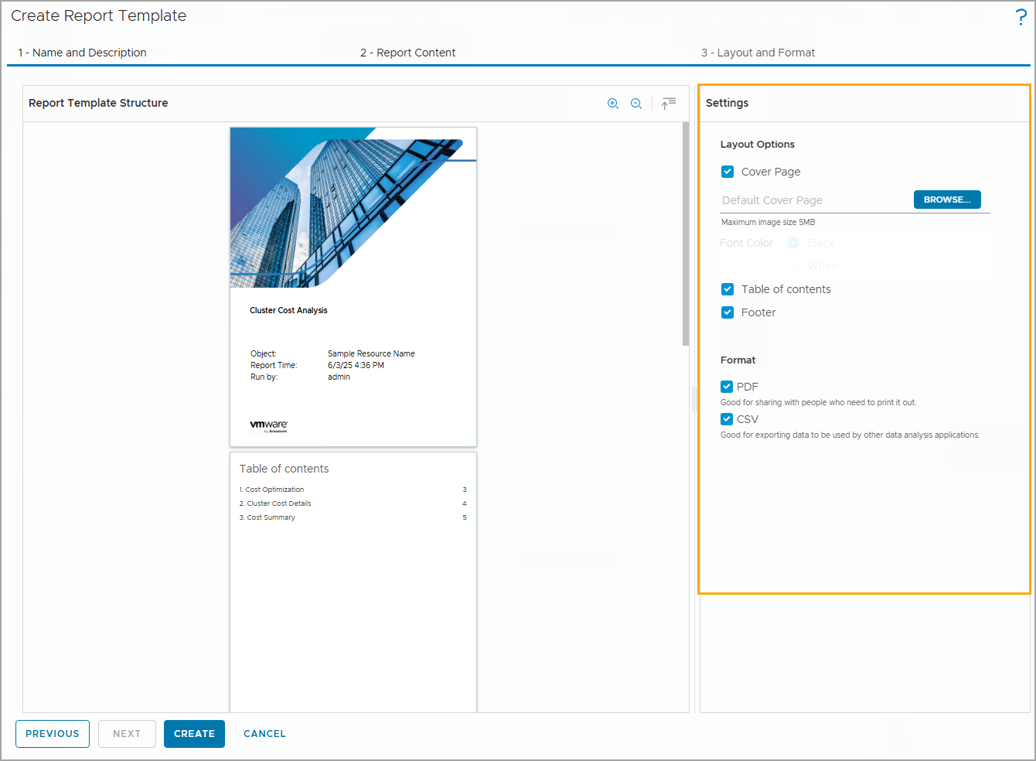
Configuring the Report Layout
The report template provides the following layout options:
Select Cover Page to include an image up to 5 MB. The default report size is 8.5 inches by 11 inches. The image is resized to fit the report front page.
Select Table of contents to include a list of the template parts, organized in the order of their appearance in the report.
Select Footer to include the date when the report is created and when VCF Operations creates the report with the page number.
Notes:
TalkTrack:
This slide focuses on "Configuring the Report Layout," which is the third and final step in creating a custom report template. This step allows you to define how your report will be presented, ensuring it meets your professional and organizational standards. The report template provides several layout options that you can customize. You can choose to include a "Cover Page" by uploading an image up to 5 MB in size; this image will be automatically resized to fit the default report size of 8.5 by 11 inches. This provides a branded and professional introduction to your report. You can also select to include a "Table of contents," which will list all the parts of the template, organized by their appearance order within the report. This greatly enhances the navigability and readability of longer reports. Lastly, you can opt to include a "Footer," which will automatically display the date when the report was created and the page number when VCF Operations generates the report. These layout options, combined with the ability to export in PDF or CSV formats, ensure that your custom reports are comprehensive and well-structured.
<End>

Slide 41
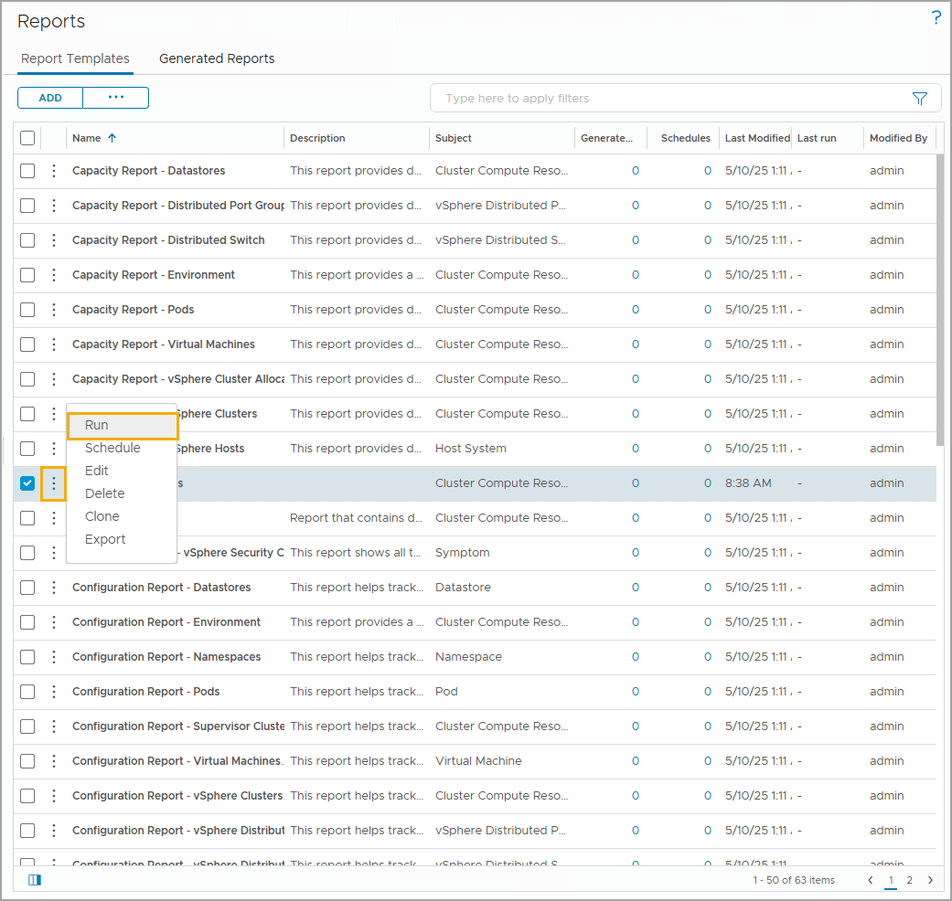
Generating Reports
Any predefined or user-created template is available on the Report Templates tab.
Click the vertical ellipsis next to the template name and click Run to generate a report.
You can see the number of reports generated from each template and when it was last used.
Notes:
TalkTrack:
This slide covers the process of "Generating Reports" from your established report templates. Once you have a predefined or user-created report template available in the "Report templates" tab, you can easily generate a report from it. To generate a report, simply locate the desired template in the list and click the vertical ellipsis icon next to its name. From the options that appear, select "Run" to initiate the report generation. This menu also provides other management options such as editing the schedule, deleting the template, cloning it, or exporting the report. The "Generated Reports" tab allows you to monitor the status of reports generated from each template, including how many reports have been created and when they were last used. It is important to note the implications of certain actions. If you edit an existing report template and then generate a report from it, any reports previously generated from the original, unedited template will be deleted. Conversely, when you clone a report template, any changes made to the clone will not affect the source template, providing a safe way to experiment with new configurations. Also, deleting a report template will delete all reports that were generated from it. For organizational purposes, you can sort the listed report templates by various criteria such as name, description, subject, last modified date, last run, or the user who modified them. Each time you re-run a report, the generated reports counter will increment.
<End>
You can select a report template from the list and click the vertical ellipsis against each report template. You can select the settings such as run, edit, schedule, delete, clone, and export a report.
If you edit a report template and then delete it, reports generated from the newly changed template are deleted. Reports generated from the original template are also deleted. When you clone a report template, the changes that you make to the clone do not affect the source template. Deleting a report template, deletes all the generated reports.
You can order the listed report templates by name, description, subject, date they were modified, last run report, or the user who modified them.
The Generated reports number increments when you rerun a report.

Slide 42
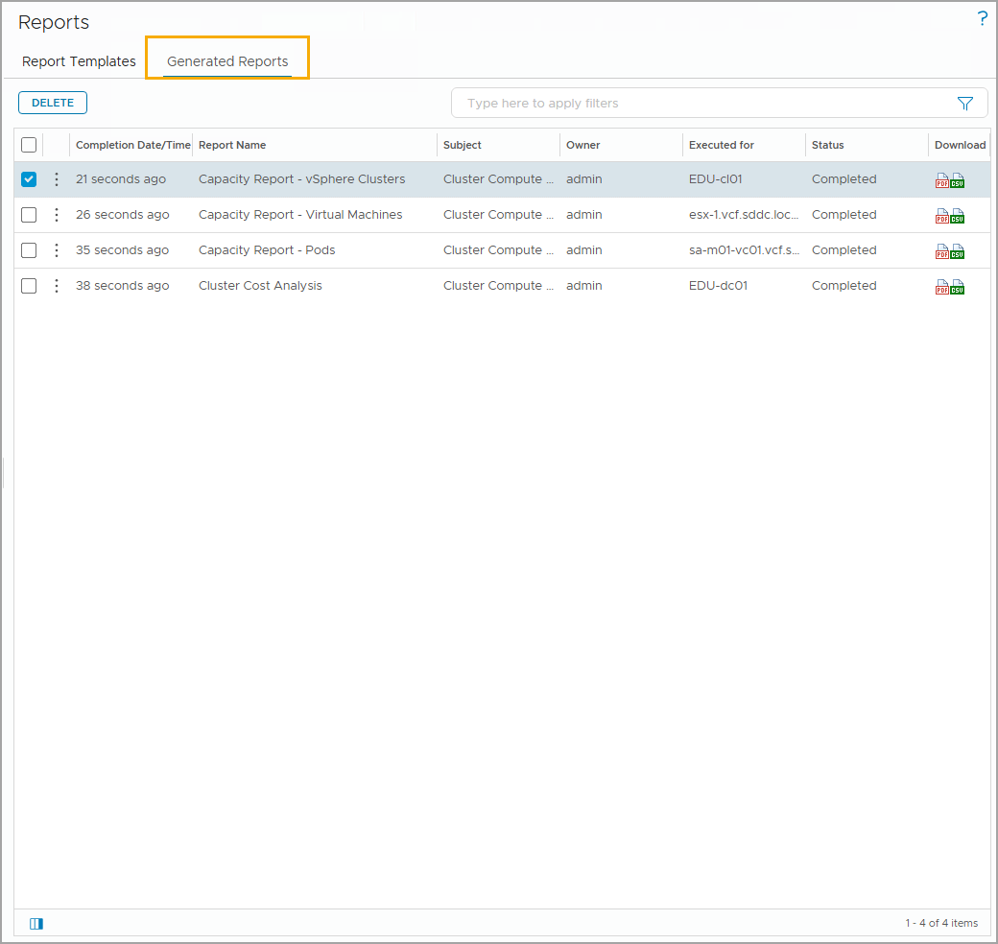
Viewing Generated Reports
You can view generated reports on the Generated Reports tab. You can download the selected report or delete any generated reports.
Notes:
TalkTrack:
This slide focuses on "Viewing Generated Reports," which is the final stage in the reporting process. After you have generated reports from your templates, you can access and manage them conveniently under the "Generated Reports" tab within the Reports section. This tab provides a comprehensive list of all reports that have been generated. From here, you have several options for managing these reports. You can easily download any selected report for offline viewing or archiving in your preferred format, such as PDF or CSV. Additionally, for organizational purposes or to free up space, you have the ability to delete any generated reports that are no longer needed. This centralized view and management capability ensure that you can effectively handle all your VCF Operations reports.
<End>

Slide 43
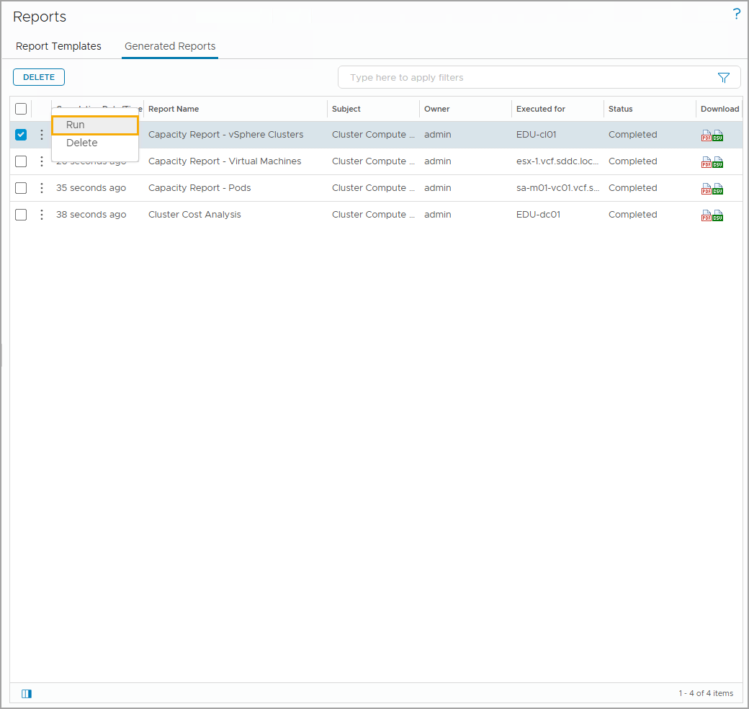
Regenerating Reports
All reports that are generated for a selected object appear on the Generated Reports tab.
You can download or run the selected report again from this location.
Regenerating a report increments the Generated reports number. The maximum number of reports generated per template is 10.
Notes:
TalkTrack:
This slide focuses on "Regenerating Reports," which is an important aspect of managing your reporting in VCF Operations. All reports that have been generated for a selected object are accessible under the "Generated Reports" tab. From this tab, you have the flexibility to download a selected report in either PDF or CSV format, or to run it again. To regenerate a specific report, you simply click the vertical ellipsis next to the desired generated report and select "Run". It is important to note that each time you regenerate a report, the count of generated reports for that template increments. The system maintains a maximum of 10 generated reports per template. Once the tenth report is generated, VCF Operations will automatically delete the oldest report to maintain this limit. This ensures that you always have access to recent reports while managing storage effectively.
<End>
You can download the generated report from the Generated Reports tab in PDF or CSV format. To regenerate the selected report, you click the vertical ellipsis next to the generated report and select Run. The Generated reports number increments when you regenerate the report. After the tenth report is generated, VCF Operations deletes the oldest report.

Slide 44
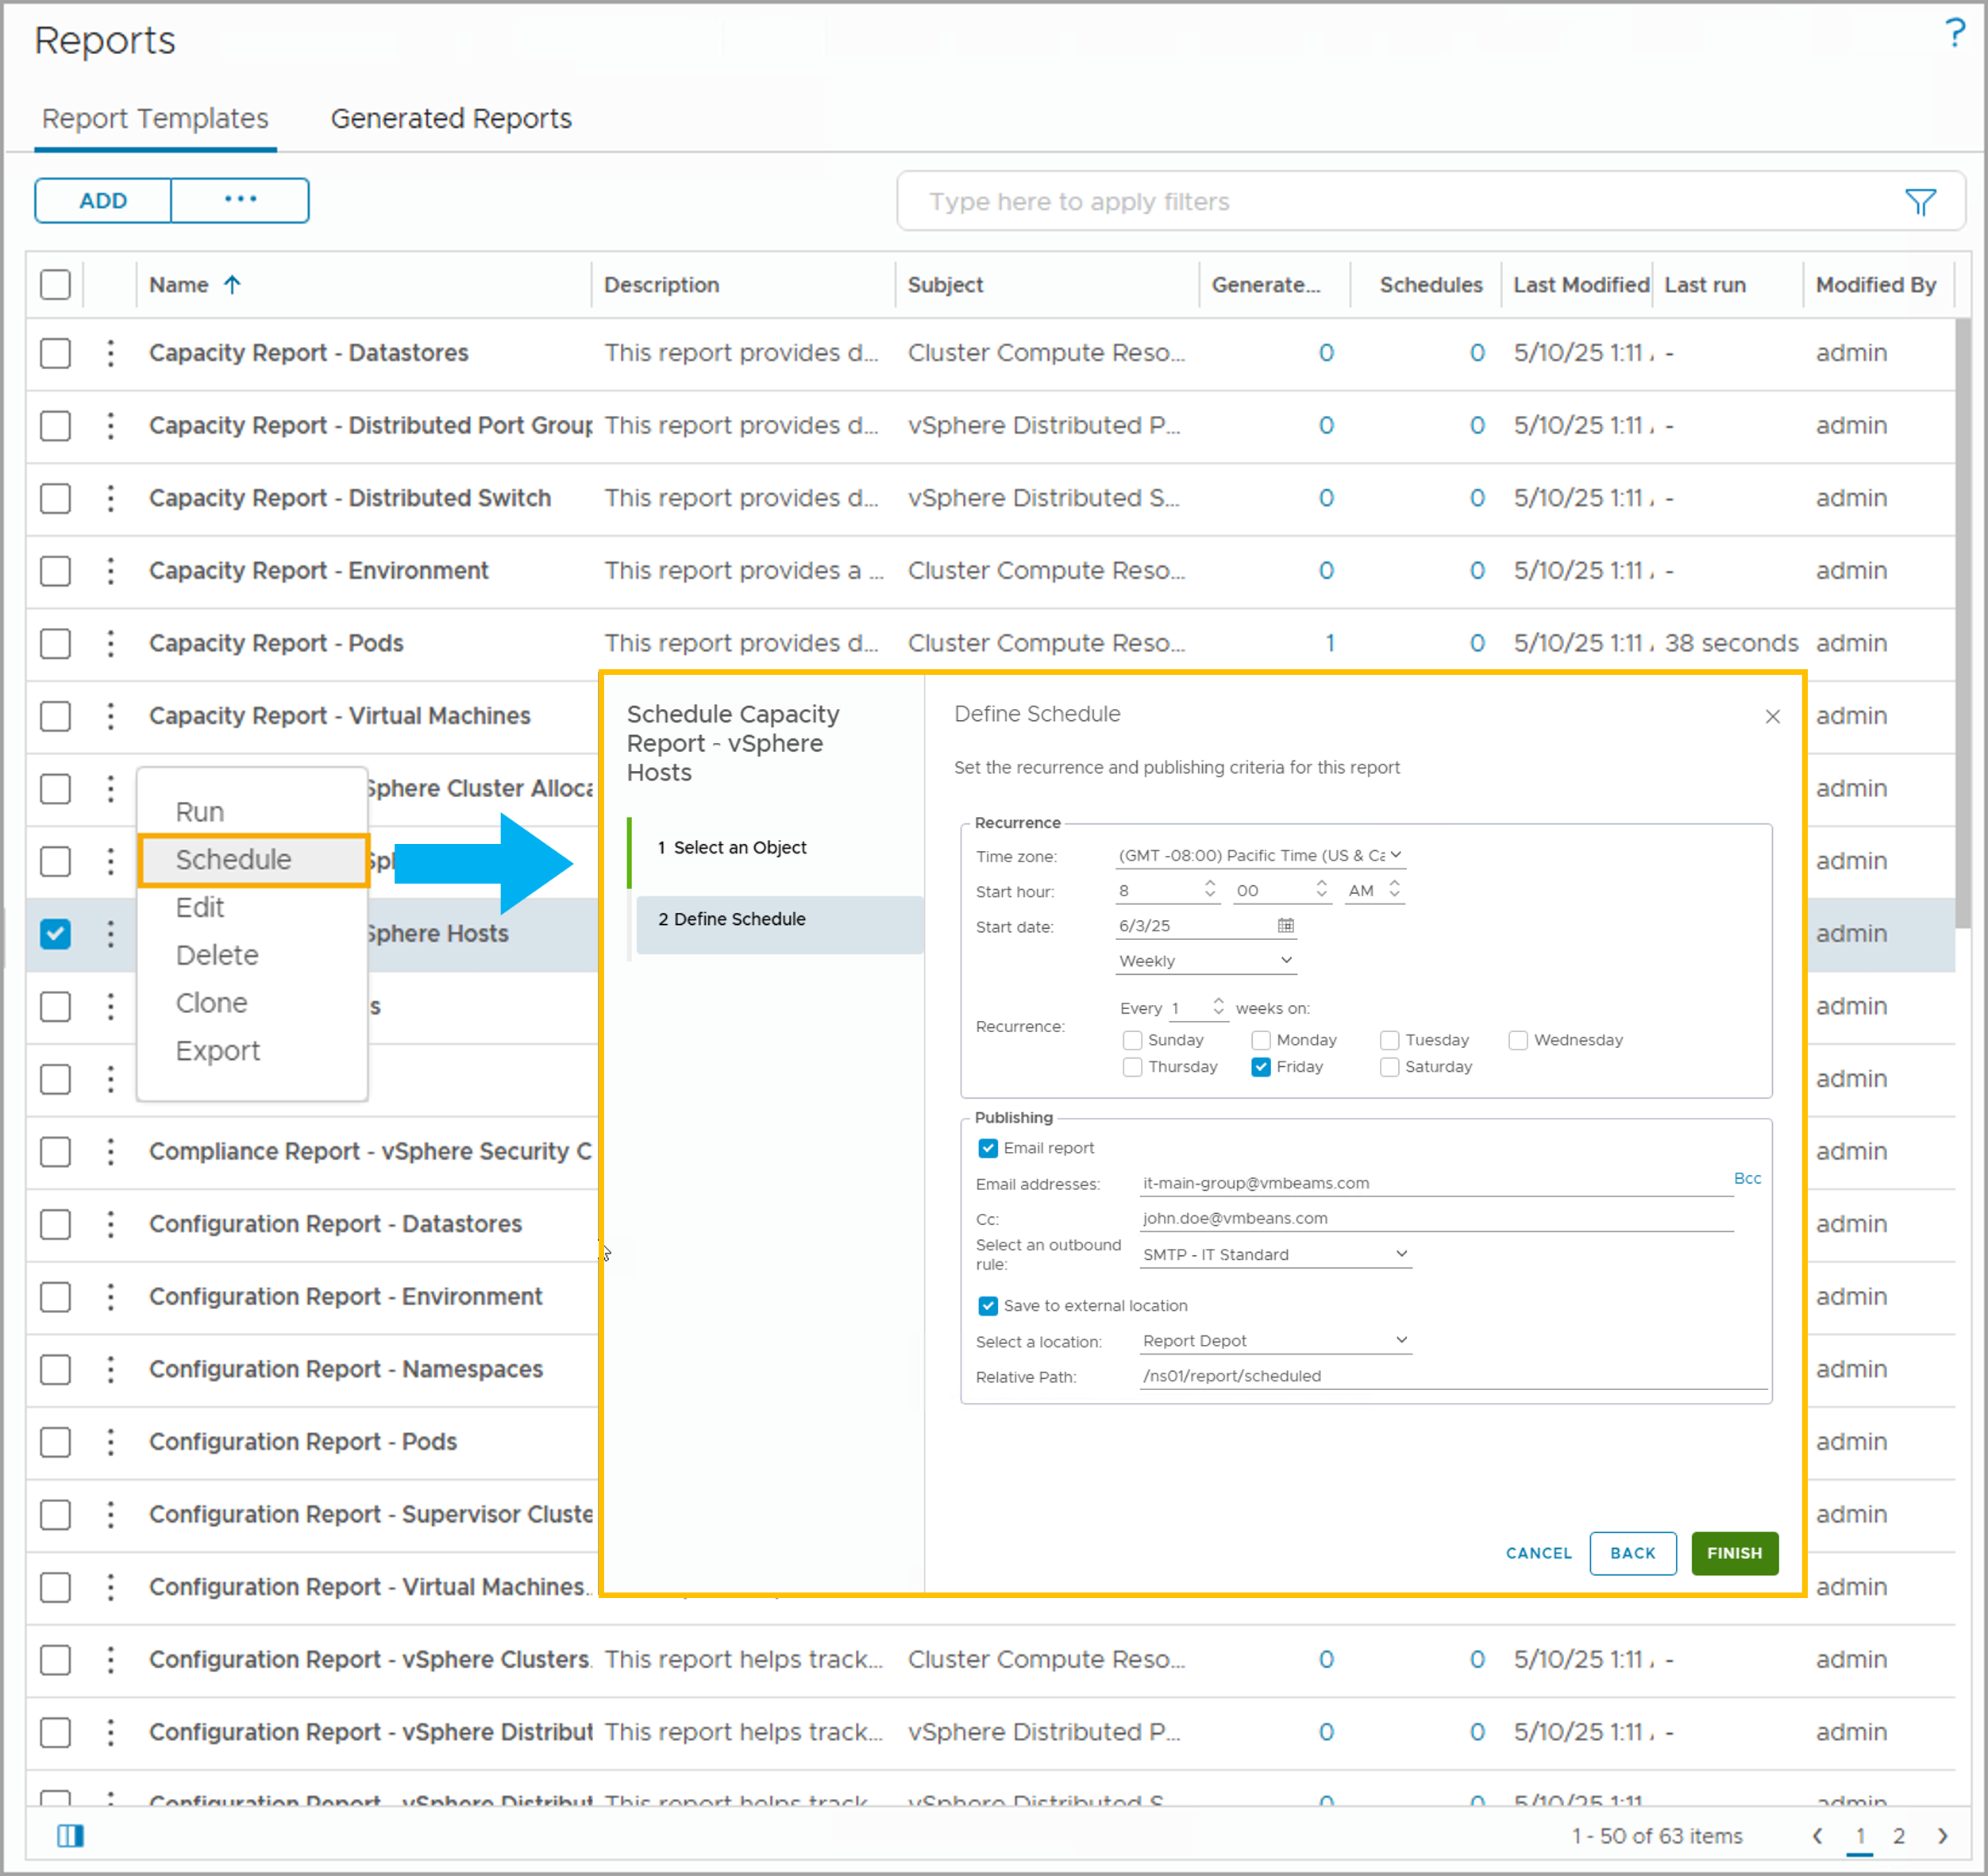
Scheduling a Report
To generate a report on a selected date, time, and recurrence, you select the object to run the report against and create a schedule for the report template.
Notes:
TalkTrack:
This slide introduces the capability to "Schedule a Report" in VCF Operations, allowing for automated report generation at predefined intervals. This feature is invaluable for ensuring that critical operational status information is consistently delivered without manual intervention. To schedule a report, you will first select the object against which you want to run the report. Then, from the report templates list, you click the vertical ellipsis next to the desired template and choose the "Schedule" option. In the scheduling panel that appears, you can configure the specific date and time for the report to run, its recurrence pattern (such as daily, weekly, or monthly), and an end date if the schedule is not meant to be perpetual. It's important to understand that the data range included in the generated report is determined by the time VCF Operations actually generates the report. Keep in mind that VCF Operations processes scheduled reports sequentially, and the generation process can sometimes take hours, potentially delaying the start time of subsequent reports if previous ones take an extended duration. To keep stakeholders informed, you have the option to configure email notifications to be sent every time a report is generated.
<End>
The date range for the generated report is based on the time when VCF Operations generates the report. Delays in starting the report affect the time range included. VCF Operations generates the scheduled reports in a sequential order. Generating a report can take hours. The process might delay the start time of a report when the previous report takes extended time. You can configure an email notification every time a report is generated.

Slide 45
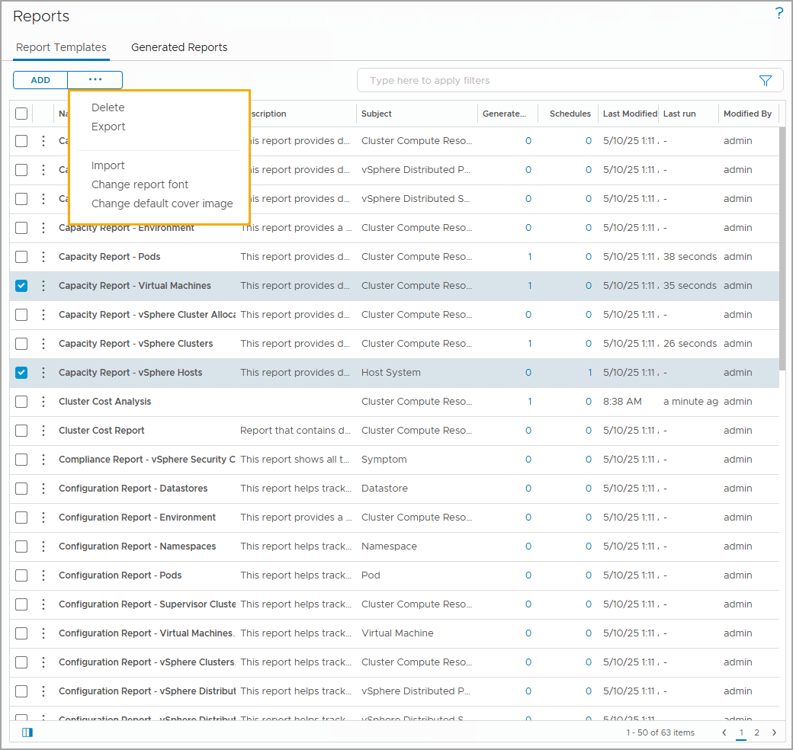
Reporting Template Actions
You can delete, export, and import report templates from the Actions menu.
You can also upload a common default image for the cover page of reports.
The cover pages of user-defined reports do not change when you update the default cover page image.
Notes:
TalkTrack:
This slide covers "Report Template Actions," which are the various management operations you can perform on your report templates within VCF Operations. From the "Actions" menu, you have the ability to delete, export, and import report templates. The "Delete" option removes a template, while "Export" allows you to download its configuration for backup or transfer. The "Import" function enables you to bring existing template configurations into your environment. Beyond these, you can also upload a common default image to be used for the cover page of your reports. This is a useful feature as it means you do not have to upload a cover page for each individual report you create. It is important to note that when you use this option to update the default cover page image, the cover pages of predefined reports will be modified. However, the cover pages of any user-defined reports you have created will remain unchanged, preserving their specific configurations.
<End>
You can upload a common default image for the cover page of reports. You can use this option so that you do not have to upload a cover page for each report. The cover pages of predefined reports are modified when you use this option. However, the cover pages of user-defined reports do not change.

Slide 46
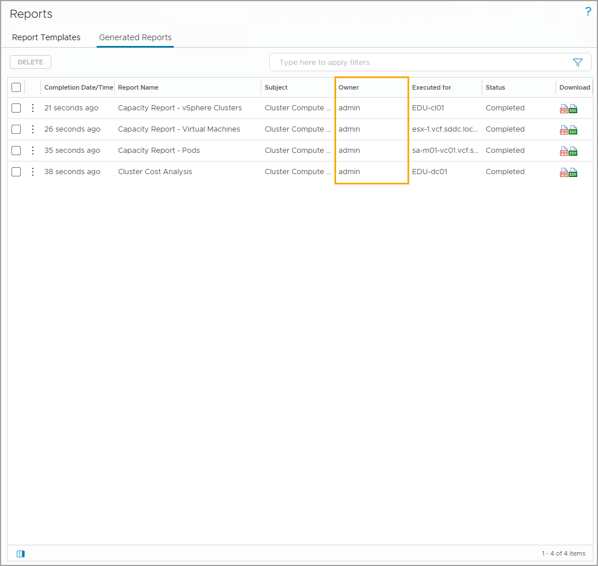
Understanding Report Template Ownership
By default, the owner of the report template is the user who creates the template. Any VCF Operations user can see the report template and run the template to generate reports. A generated report is user specific.
When the user is deleted, all the report templates owned by the user are automatically transferred to the System account.
Notes:
TalkTrack:
This slide provides important details about "Understanding Report Template Ownership" within VCF Operations. By default, the individual user who creates a report template is designated as its owner. Any VCF Operations user with appropriate permissions can view that report template and run it to generate reports. It is important to note that a generated report is user specific, meaning it is associated with the user who initiated its generation. A key administrative consideration arises when a user account is deleted. In such cases, all report templates previously owned by that user are automatically transferred to the system account. This ensures that valuable report templates are not lost when a user departs. However, it's critical to understand that while the templates are transferred, the reports generated from those templates are not; they are deleted along with the user account. This distinction is vital for maintaining data integrity and retention policies within your environment.
<End>
If multiple report templates are deleted, all the user’s report templates are transferred to the System account by default. Reports generated from the template are not transferred. All reports generated from the template are deleted with the user account.

Slide 47
Best Practices for Creating and Using Views and Reports
When you create or use views and reports, you can follow these best practices:
Use views and reports that are available and predefined: Use the predefined views and reports that provide the needed information.
Clone views or reports to make changes and rename with your company’s naming convention: If minor changes are needed from a predefined view or report, clone the predefined view or report before making changes and save it with a naming convention that identifies the company. The cloned view or report can be easily identified and exported for future use.
Create customized views and reports: Customize views and reports based on the dashboards and reports that must show the precise information. Use your customized views for your customized dashboards and customized reports.
Notes:
TalkTrack:
This slide summarizes "Best Practices for Creating and Using Views and Reports" in VCF Operations, offering guidance to optimize your experience. First, a fundamental best practice is to leverage the views and reports that are already available and predefined within the system. These predefined options are often designed to provide commonly needed information efficiently. Second, if you find that a predefined view or report almost meets your needs but requires only minor adjustments, it is highly recommended to clone it. After cloning, you can make the necessary changes and rename the cloned view or report using your company's specific naming convention. This approach ensures that your changes do not affect the original predefined versions and makes the cloned assets easily identifiable and exportable for future use. Finally, for more specific or unique requirements, you should create customized views and reports. These custom assets allow you to tailor the information presented in dashboards and reports to show precisely the data and insights that are most relevant to your operational needs.
<End>

Slide 48
Lab: Creating Custom Report Templates
Create report templates that can generate required information about your private cloud environment:
Create a Report Template Using the Virtual Machine Configuration Summary View
Create a Report Template Using Two Dashboards

Slide 49
Review of Learner Objectives
Outline the roles of reports in VCF Operations
Create a basic report and configure report settings
Create a custom report template

